Slide 1
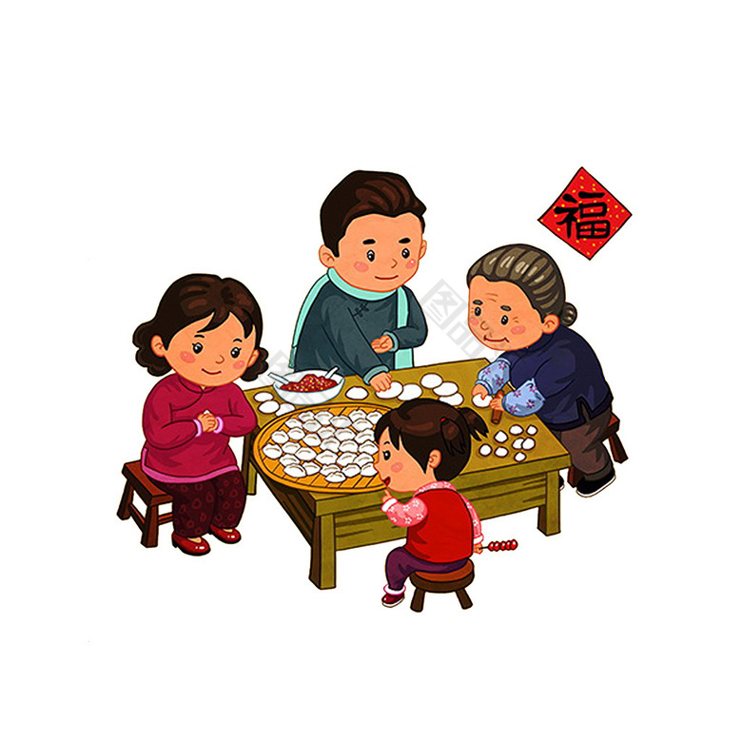
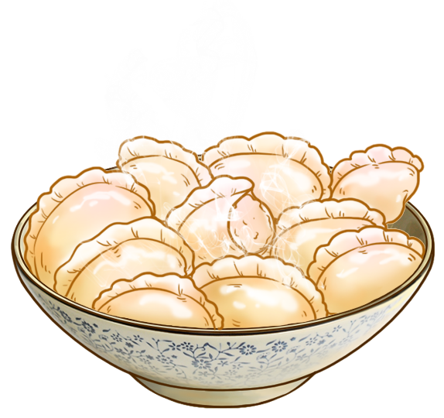
Chinese Traditional Food
Dumplings
Jiao Zi

Slide 2
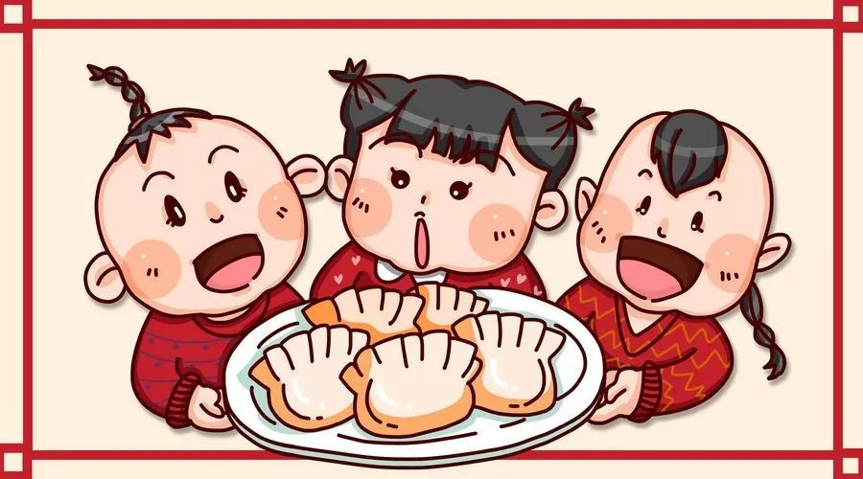
Catalogue
1
The origin and development
2
The meanings
The process of making dumplings
3
The values
4

Slide 4
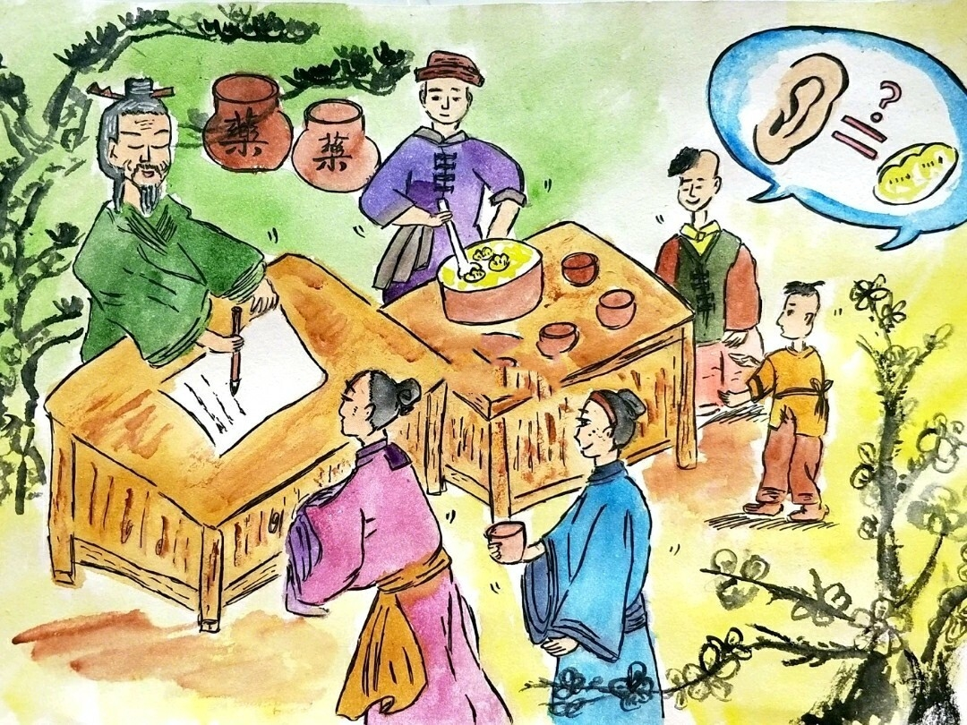
01
The origin and development

Slide 5
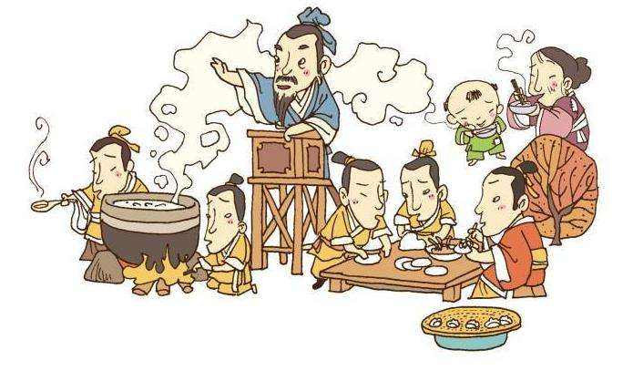
01.The origin

Slide 6
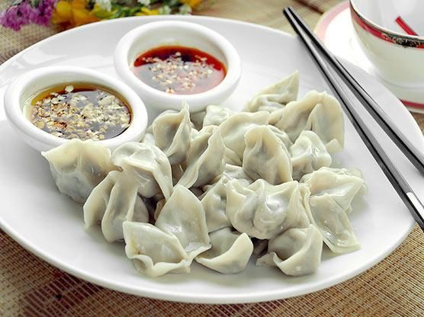
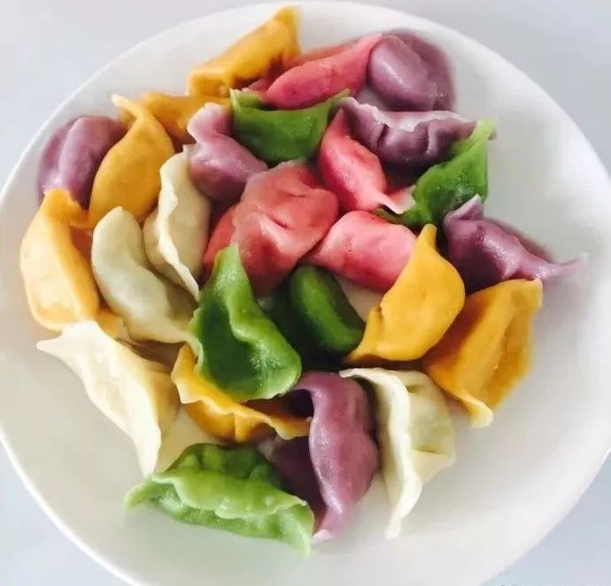
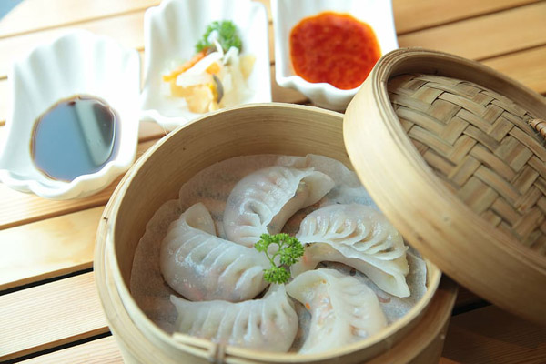
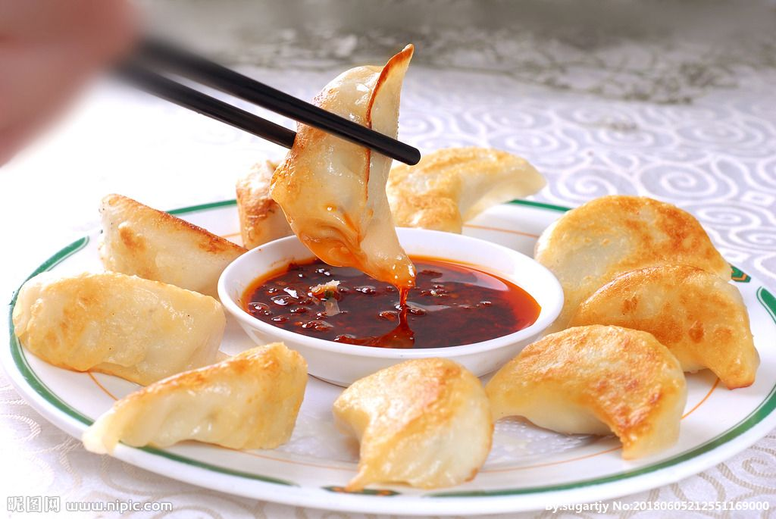
01.The development
Names:
Jiaoer (娇耳）——Dong Han dynasty
Jiaozi (角子）——Song dynasty
Bianshi (扁食）——Yuan dynasty
Jiaozi(饺子）—— Qing dynasty
Ways to eat:
Boiled dumplings:(shuijiao)
Steamed dumplings (zhengjiao)
Shallow fried dumplings (jianjiao)

Slide 7
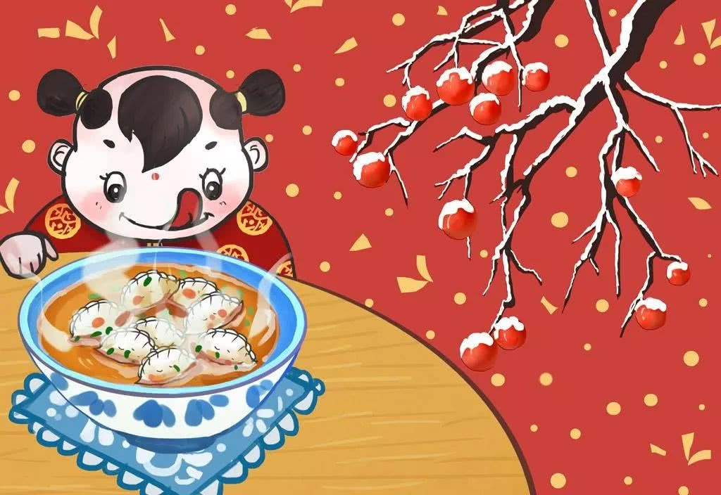
02
The meanings

Slide 8
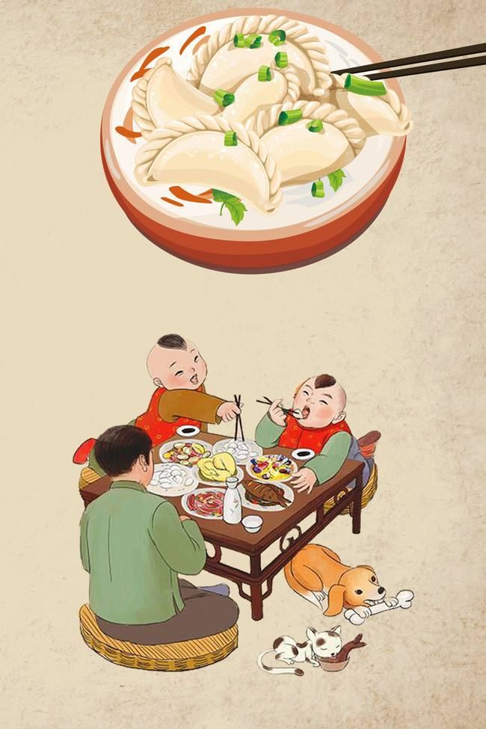
Why can it represent Chinese traditional food culture?
1
Jiaozi (交子）、Jiaozi(饺子）
2
Making jiao zi together with the whole family creates a unique, harmonious atmosphere.
3
A symbol of Chinese traditional food.

Slide 9
02.The meanings
Jiaozi (交子）、Jiaozi(饺子）
As for the shape ,crescent-shaped Jiaozi are a symbol of wealth and prosperity because of their resemblance to ancient Chinese money - gold ingots.
As for the pronunciation, “jiao zi” sounds like “jiao zi”,which means the hour of transition into the New Year. Hence, in northern China, dumplings filled with meat are eaten on Chinese New Year’s eve to usher in good luck and wealth in the New Year.

Slide 10
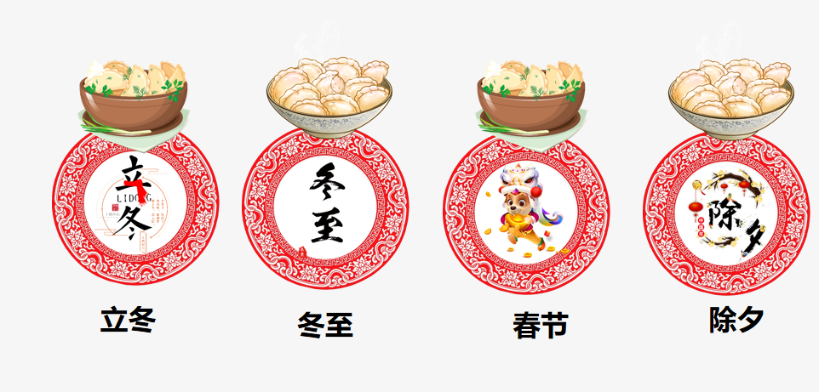
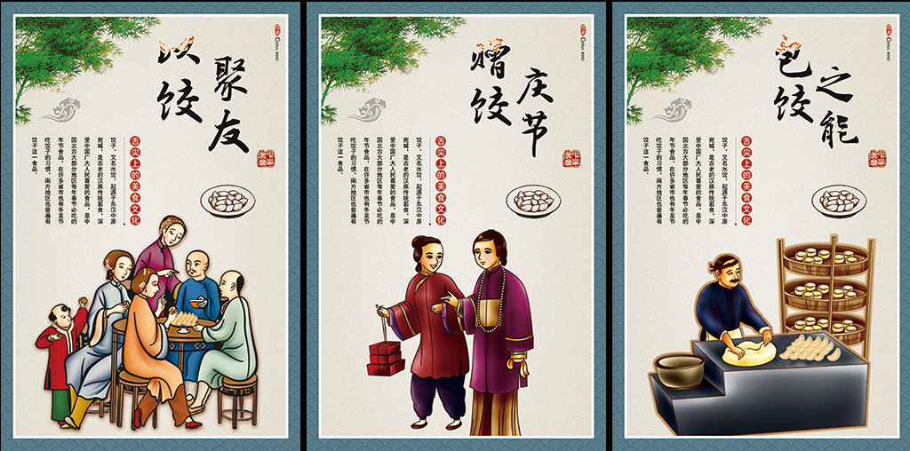
02.The meanings
Making jiao zi together with the whole family creates a unique, harmonious atmosphere.
Chinese people like eating dumplings, jiao zi, for their delicious taste and auspicious meanings. In Chinese philosophy, harmony is advocated in every aspect: in society, in governing country, in developing relationship with other people. Making jiao zi together with the whole family creates a unique, harmonious atmosphere. Nowdays,people make and eat dumplings whennever they like.

Slide 11
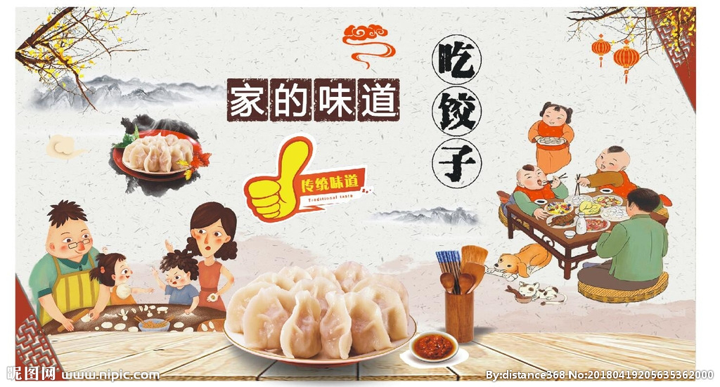
02.The meanings
A symbol of Chinese traditional food.
Dumpling is a symbol of China's long - standing, extensive and profound food culture.Eating dumplings during the Spring Festival is a kind of folk culture, which is an inheritance of Traditional Chinese culture.

Slide 12
03
The process of making dumplings

Slide 13
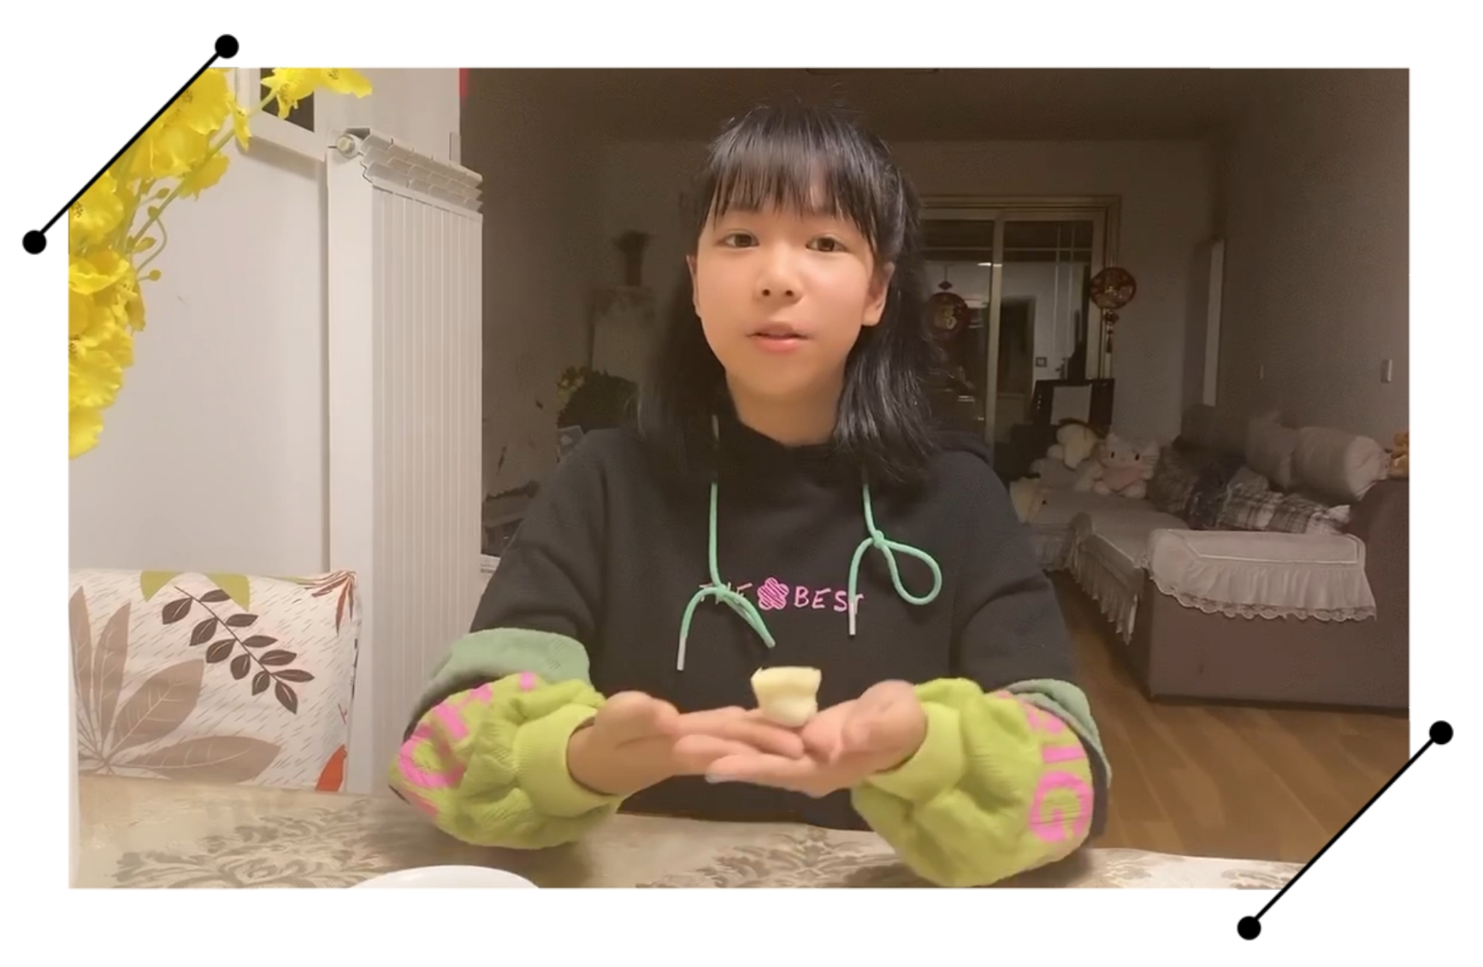
03. The process of making dumplings
Dumplings or Jiaozi is essential during holidays in Northern China. Chinese are Masters in the Art of Making Dumplings.

Slide 14
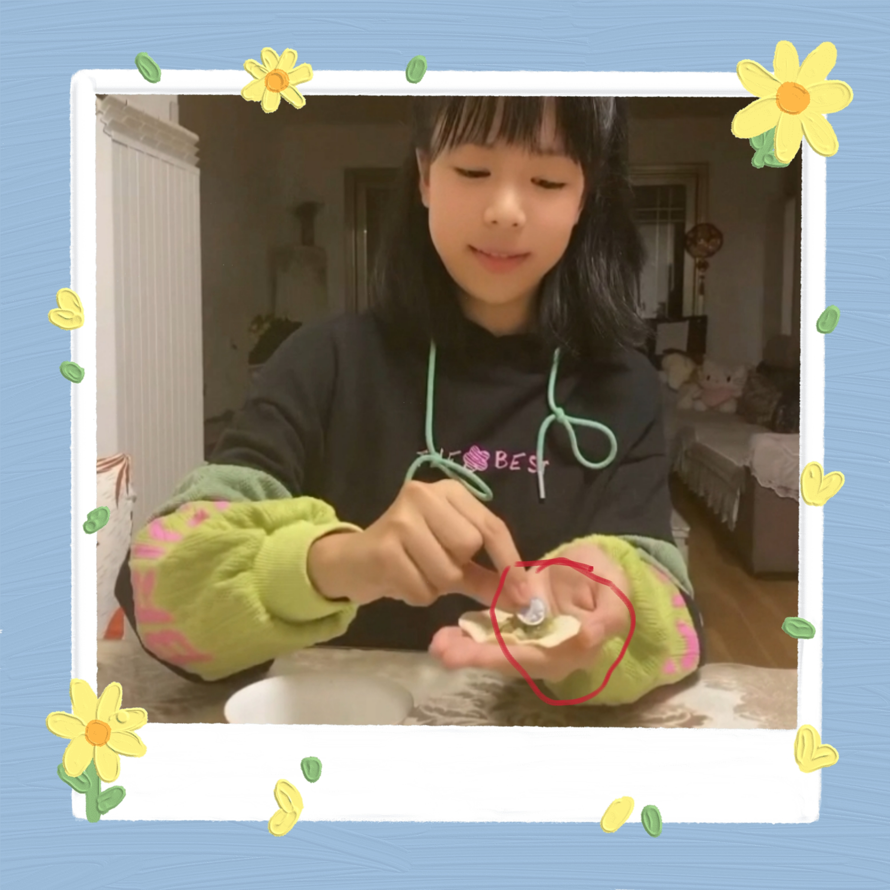
Think about and discuss:
Why did Lory put a coin in the dumpling?
It's a custom.Auspicious wishes permeate our daily life. Dumpling is seen as a tool to send auspicious wishes, too. During Spring Festival, old people always put a coin into fillings. If someone eats the only one dumpling that contains the coin in its fillings, it means the person will be very lucky in the next year.

Slide 15
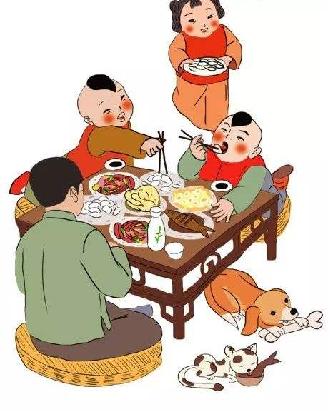
04
The values

Slide 16
04. The values
Dumplings are eaten as not only a kind of traditional food in our daily life, but also a kind of symbol of Chinese culture in other countries. Because of its typical Chinese style, dumpling has been spread all over the world. Though we live a better ilfe,we should also value the tradition and use it as a way to connect our relationship between families and friends.

Slide 17
Expansion and Innovation:
What proverbs or xiehouyu dou you know about dumplings？Collect and sort them out,you will feel very interesting.

Slide 18
Thank you !

