Slide 1
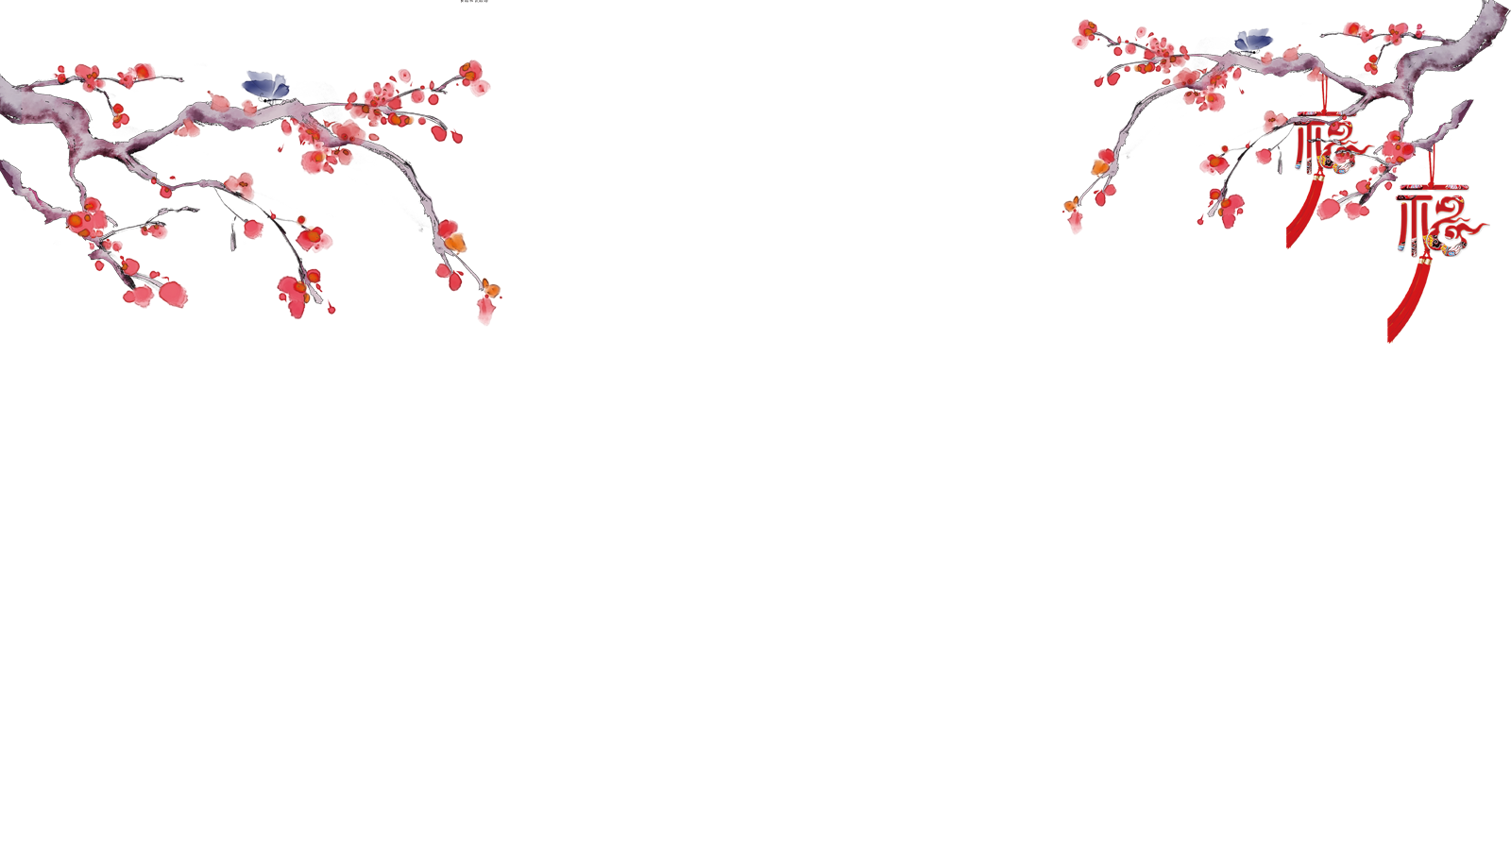
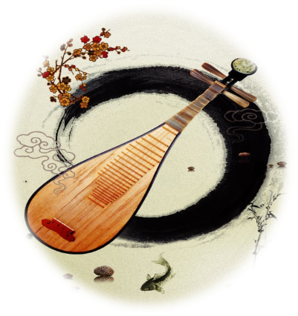
Chinese Musical Instruments

Slide 2
The history of Chinese musical instruments

Slide 3
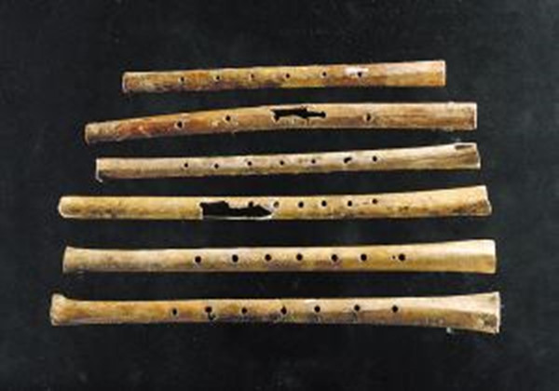
1.Ancient times (about 6000 BC-1711 BC)
According to the existing unearthed objects, wind instruments（吹奏乐器） are the earliest musical instruments.
At the same time, a lot of percussion instruments（敲击乐器） were also unearthed.
During this period, musical instruments were mainly used for hunting and dancing.
Jiahu Bone Flute (贾湖骨笛）

Slide 4
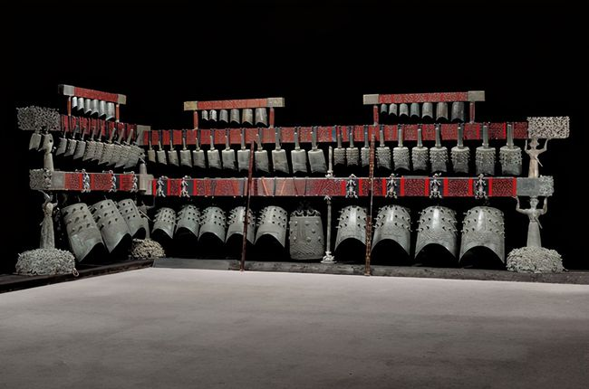
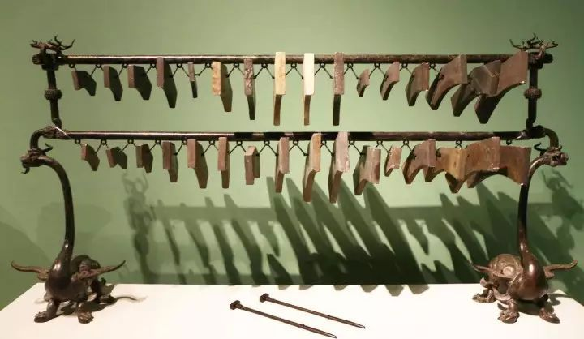
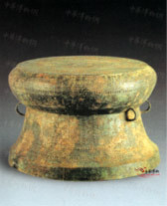
2. Pre-qin Period (711 BC-256 BC)
——the first peak in the development of Musical Instruments
Chime bells (编钟)
Stone-chime (编磬)
Drum (鼓)
They are the most majestic（威严的） ancient instruments in China .AS a symbol of power, they were used for sacrificial(祭祀） ceremonies and other crucial ceremonies in the royal court（宫廷）.

Slide 5
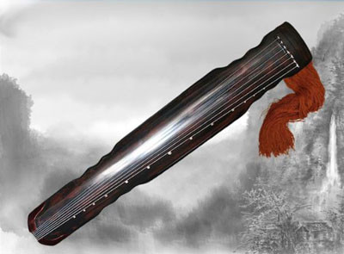
2. Pre-qin Period (711 BC-256 BC)
——the first peak in the development of Musical Instruments
Chinese Zither (古琴)
---The oldest plucked instrument（弹拨乐器）. It is known as the first of the four arts and is the highest status of musical Instruments in ancient times.

Slide 6
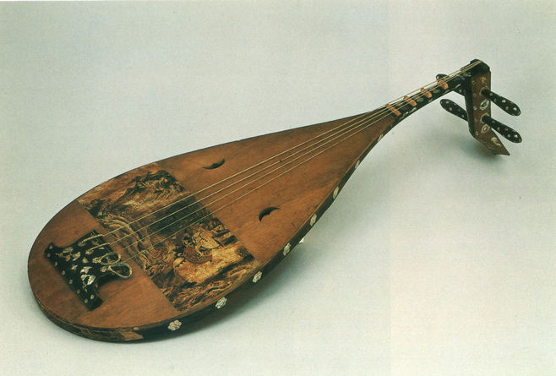
3. Qin, Han, Sui and Tang Dynasties (221 BC-960 AD)
——at the peak of the development of Musical Instruments
pipa(琵琶)
---As one of the plucked instruments, pipa is the most popular and important instrument in the Tang Dynasty.
Its music is also represented from the royal court to the street stalls.(从宫廷到民间）

Slide 7
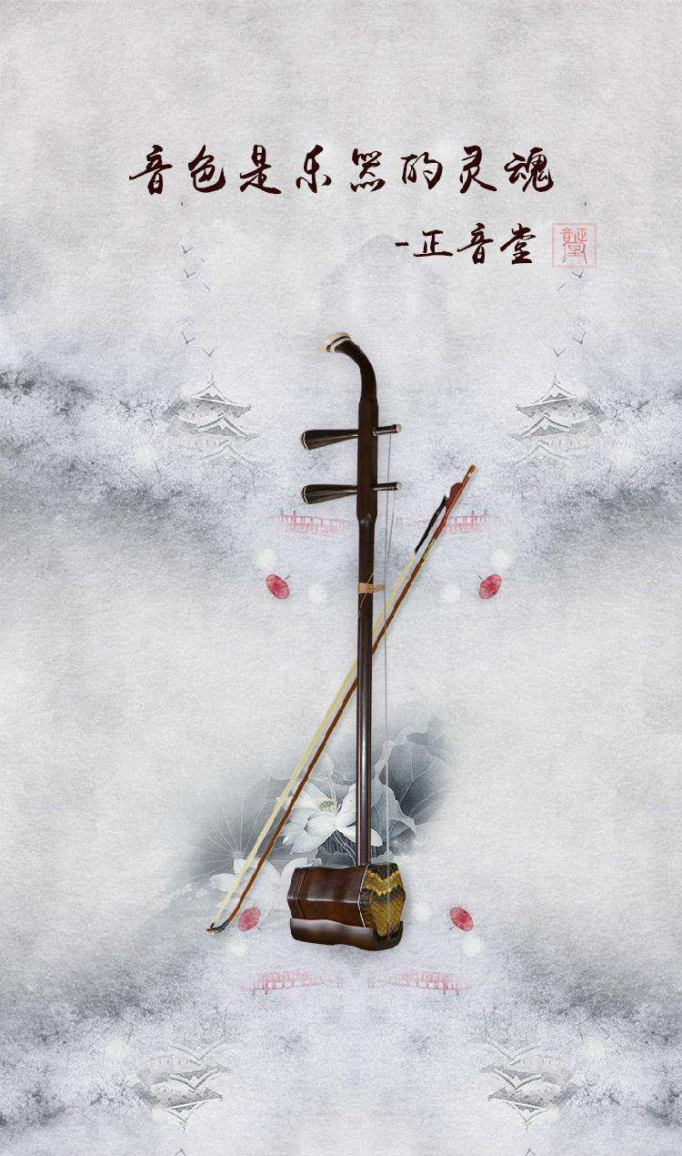
4.Song, Yuan, Ming and Qing Dynasties (960-1840)
——an important period for the bow-string instruments(弓弦乐器）
Erhu（二胡）
The introduction and widespread use of bow-string instruments promoted the development of opera and rap music.
It is known in the West as the "Chinese violin".
Notes:
The introduction and widespread use of bow-string instruments promoted the development of opera and rap music.

Slide 8
The types of Chinese musical instruments
and famous classical music

Slide 9
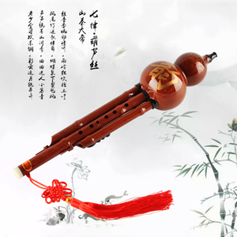
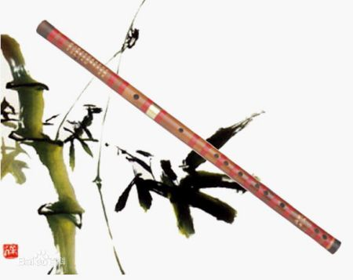
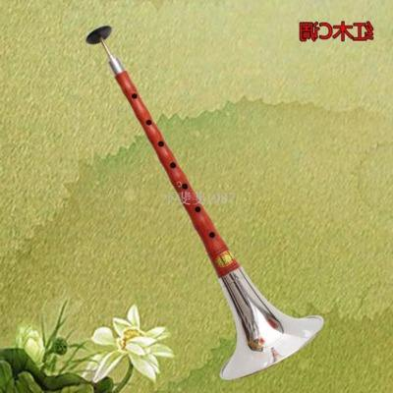
1. Wind or blowing instruments（吹奏乐器）
cucurbit flute（葫芦丝）
bamboo flute（竹笛）
suona horn（唢呐）

Slide 10
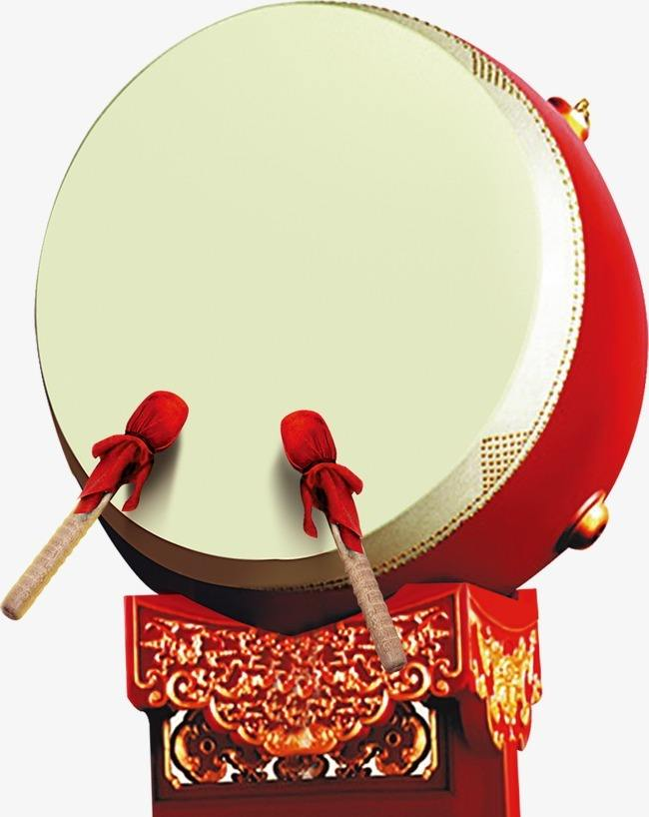
2. Percussion instruments（敲击乐器）
Chime bells
Drum

Slide 11
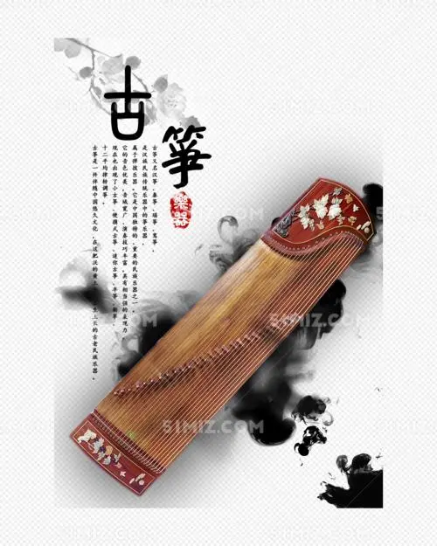
3. Plucked instruments（弹拨乐器）
Guzheng
Pipa

Slide 12
4. Bow-string instruments（弓弦乐器）
Erhu, Jinghu, Banhu...

Slide 13
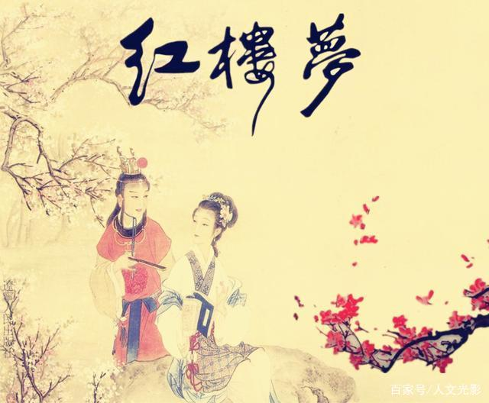
Famous classical music
A Dream of Red Mansions
Frowning in Deep Sorrow （ 枉凝眉）
The Song of Buring Flower （葬花吟）

Slide 14
Chinese Top Ten Classical Music
夕阳箫鼓 Flute And Drum At Sunset
十面埋伏 House of Flying Daggers
阳春白雪 White Snow In Sunny Spring
汉宫秋月 Autumn Moon Over Han Palace
平沙落雁 Wild Geese over the Clam Sands
梅花三弄 Three Stanzas of Plum-blossoms
渔樵问答 Dialog Between Fisherman And Woodcutter
高山流水 High Mountains And Flowing Water
胡笳十八拍 The Eighteen Beat of Wu Gier
广陵散 A Music From Guangling

Slide 15
The popularity of Chinese musical
instruments

Slide 16
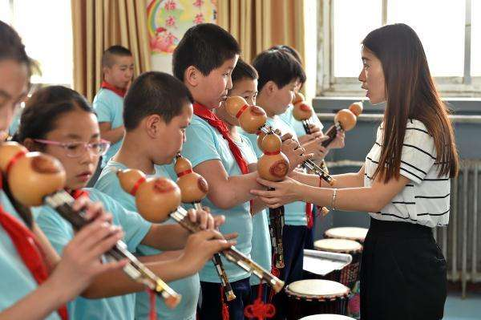
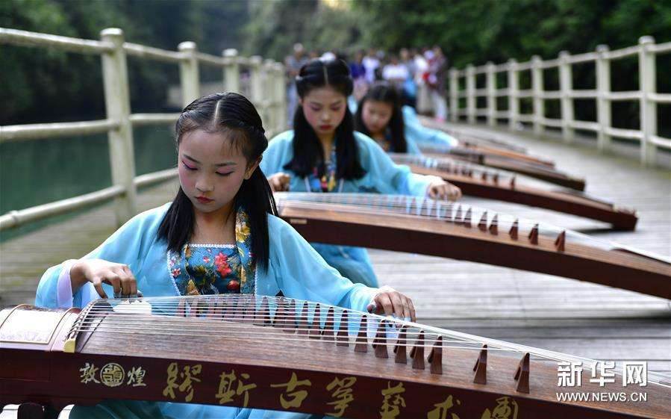
1. More and more Chinese children choose to learn the traditional musical instruments.

Slide 17
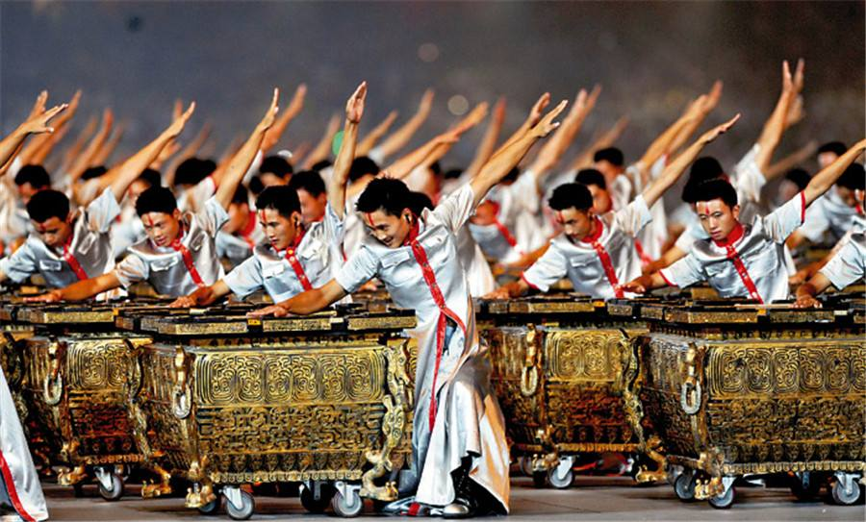
2. Chinese musical instruments are played in different occasions in China.
The opening ceremony of Beijing Olympic Games in 2008
At the important ceremonies （重要的仪式）

Slide 18
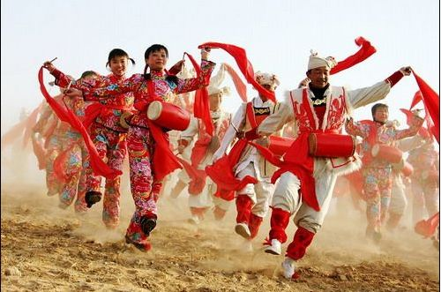
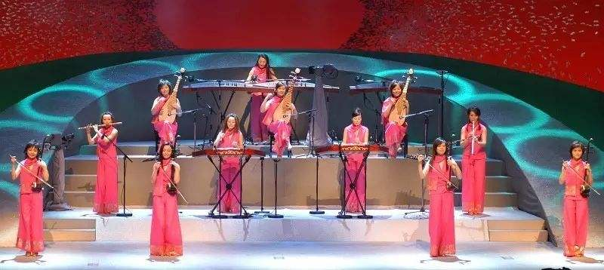
2. Chinese musical instruments are played in different occasions in China.
On tradional festivals
In music concerts

Slide 19
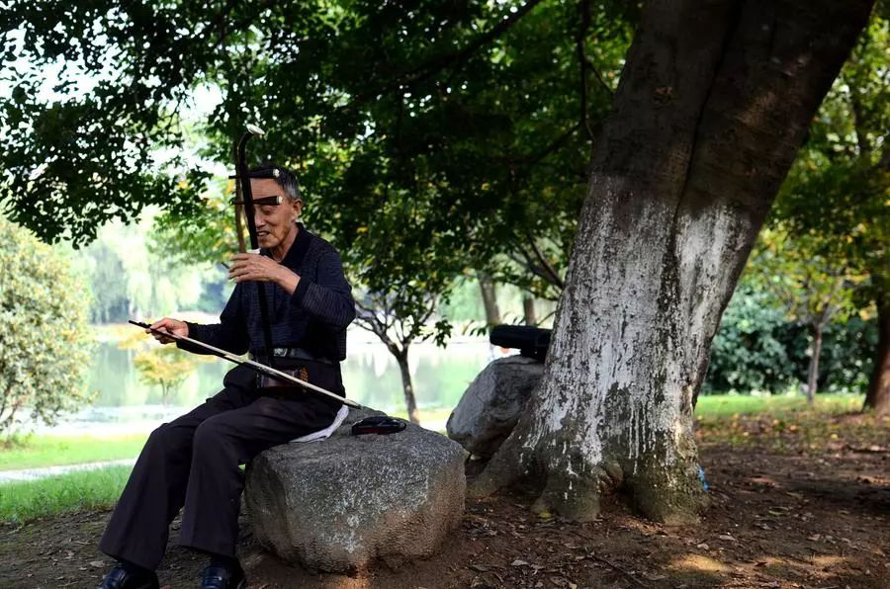
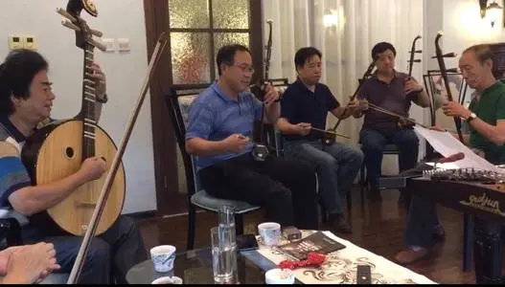
2. Chinese musical instruments are played in different occasions in China.
In the park
At home

Slide 20
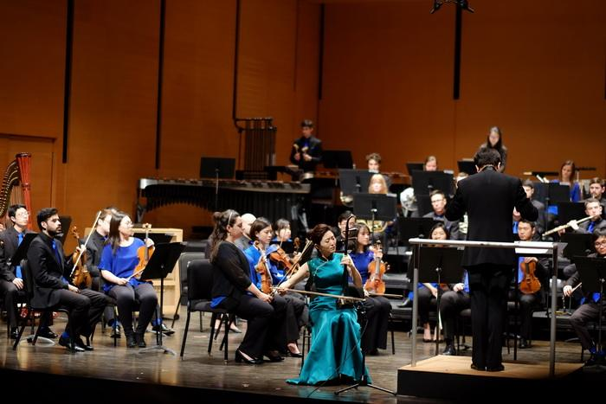
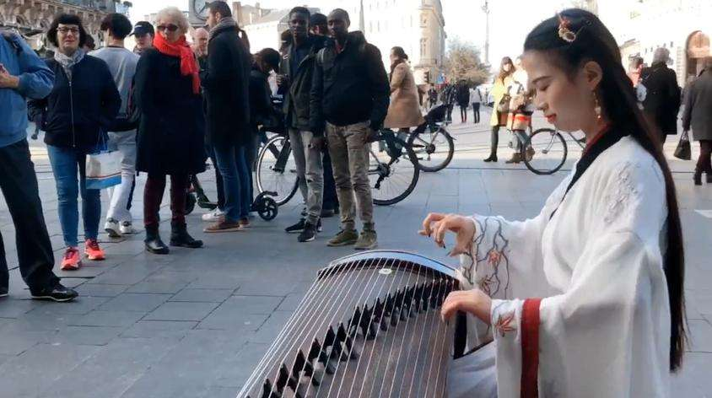
3. Chinese musical instruments are being admired by people all over the world.

Slide 21
Conclusion
Traditional musical instruments are the precious national treasure in our country , which play an important role in promoting the development of Chinese traditional culture. So, each of Chinese people has the responsibility to carry forward our culture to the world!

Slide 22
Homework
1.What Chinese musical instruments would you like to learn and why ?
2.What can you do to promote Chinese traditional culture ?

Slide 23
Thank you for listening!

