Slide 1
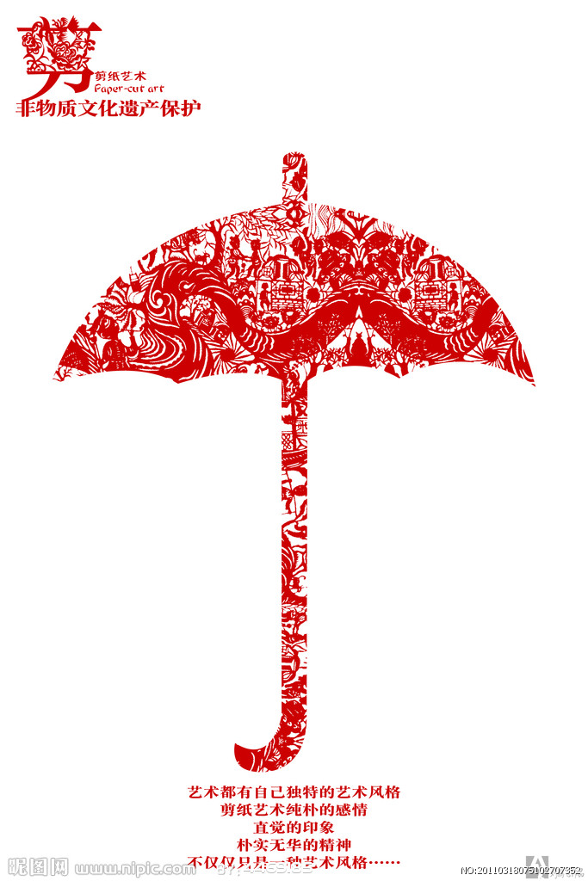
Chinese Paper-cutting
Notes:
首页

Slide 2
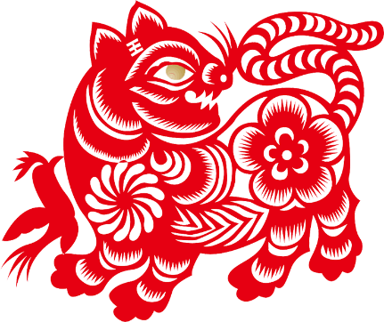
Brief Introduction
Chinese Paper cutting is one of the most popular folk arts. Paper cutting as Chinese traditional culture fully reflects people's
wisdom and hard work. It has a huge impact and a driving force on the modern society. It comes from life. It has a history of more than 1500 years.

Slide 3
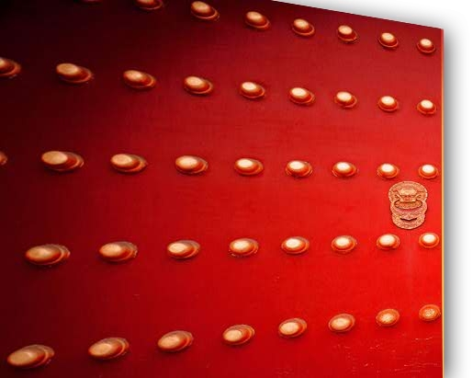
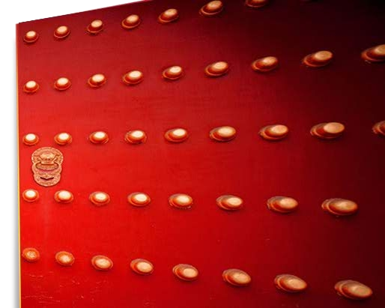
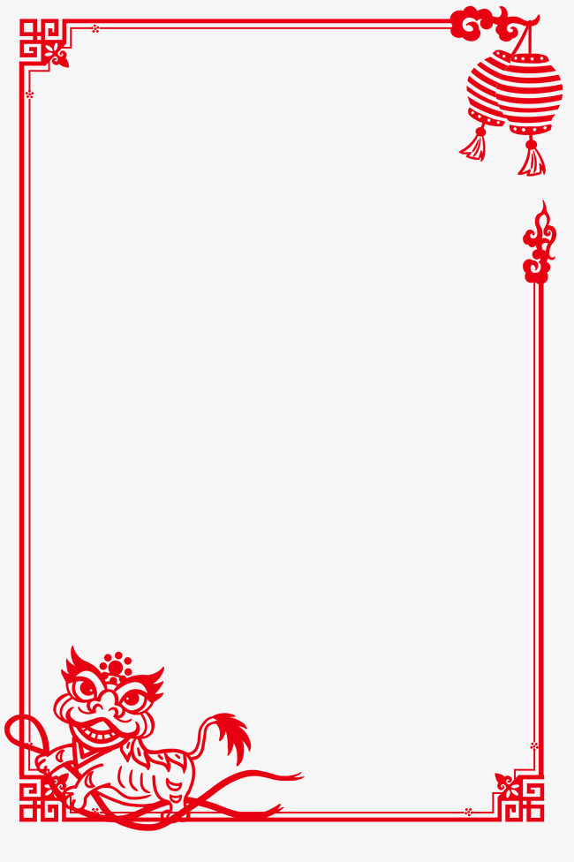
Paper cutting Hall
剪 纸 馆
History
Development
Types
Value and Impact
Methods

Slide 4
History
Paper cutting can be dated back to the 6th century. The invention of paper in the Eastern Han Dynasty combined with Chinese people’s imaginations turned blank sheets into colourful art.

Slide 5
Development
Paper cutting comes from life. The creators use
paper cutting to express their understanding
of nature, and their thoughts about life. It is
an expression of their inner feelings.
People paste papercuts on walls, windows
and doors at wedding ceremonies .

Slide 6
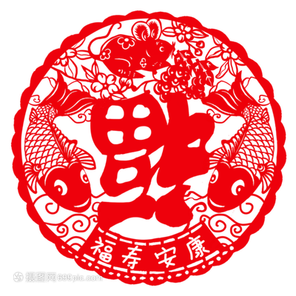
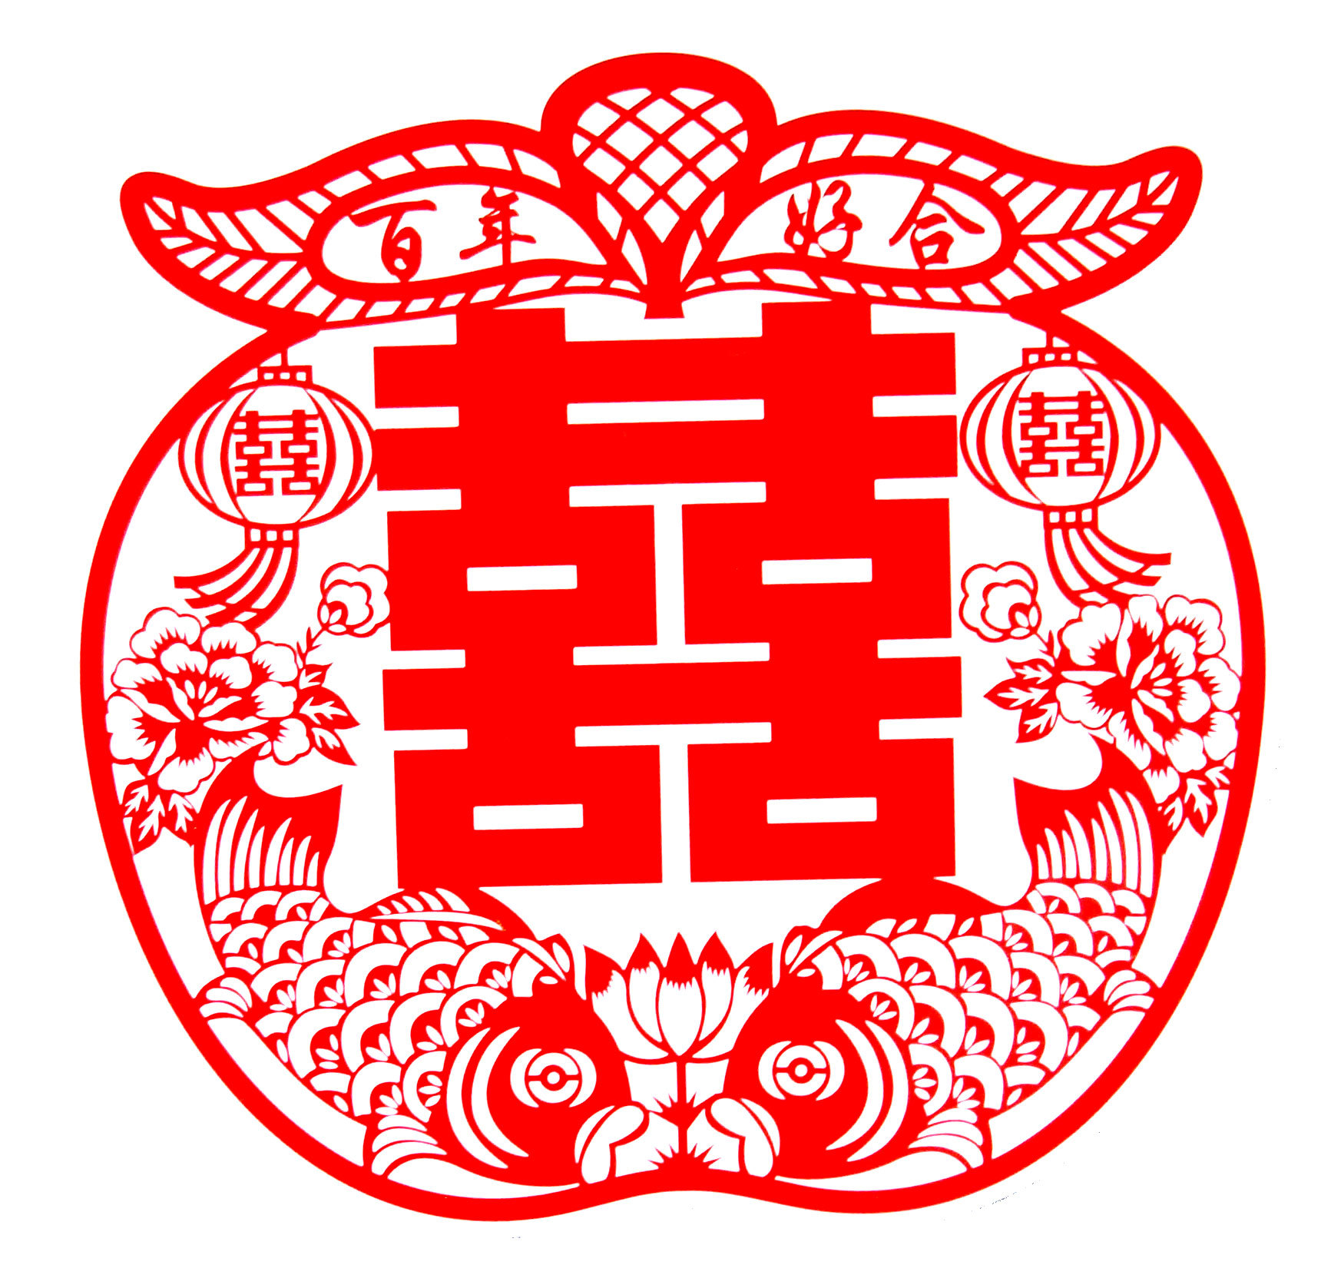
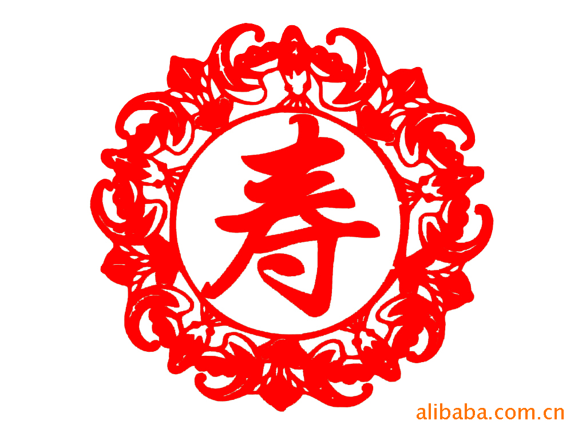
On what other occasions can we often see this kind of art?
On special occasions such as _______, ________, ________
festivals weddings birthdays …

Slide 7
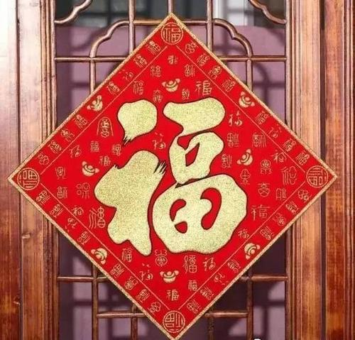
Three Types
put up
1. _______on windows and
gates to bring good ______;
2. used on__________;
luck
For decoration:
presents

Slide 8
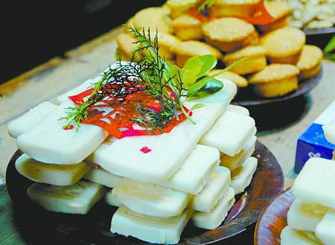
Three Types
1. often found in temples;
2. used as ________ to the dead.
For religious
purposes:
offerings

Slide 9
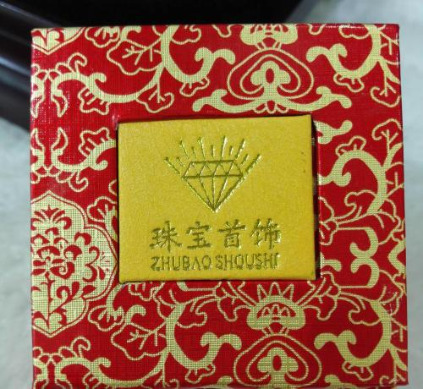
Three Types
1.used to _______________________.
2. used to _____________________
For design
patterns:
make patterns on clothing
decorate jewellery boxes

Slide 10
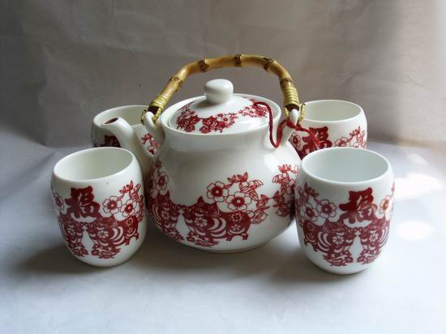
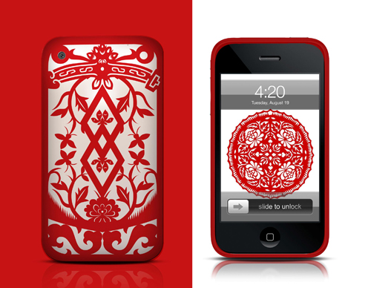
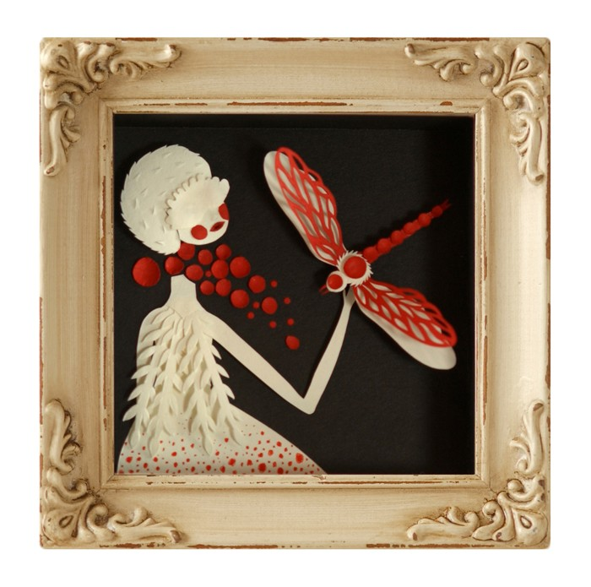
Various Purposes
tea set
mobile phone shell
mobile phone wallpaper
artwork

Slide 11
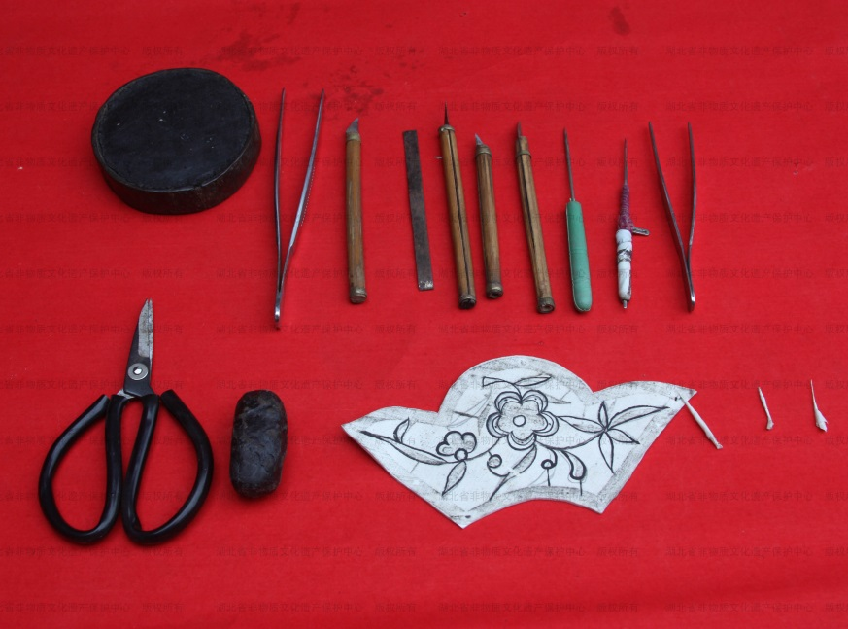
Methods
1. some red paper
2. a knife
3. a pair of scissiors
4. other tools
Tools used

Slide 12
Methods
Fold
Spiny hole

Slide 13
Method-Fold
This is the most basic kind of paper cutting technique.
Folding paper cuts are more symmetrical because of their symmetrical patterns.

Slide 14
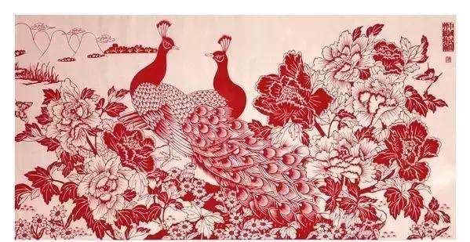
Method-Spiny hole
Use a knife or scissors to cut the basic outline on the paper, then use the needle to pierce the pattern, mainly by making the multilayer paper connected, and at the same time see the details in the rough.

Slide 15
Enjoy the Video

Slide 16
Value and Impact
Chinese paper art is not only the treasure of Chinese folk culture,but also the world intangible cultural protected heritage(世界非物质物化遗产）
We should try our best to protect Chinese folk art.

Slide 17
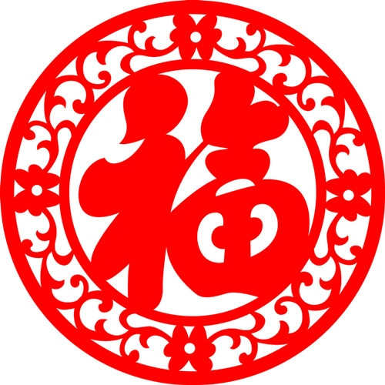
Thank you!

