Slide 1
The Past Perfect Tense
（p.p.）
过去完成时

Slide 2
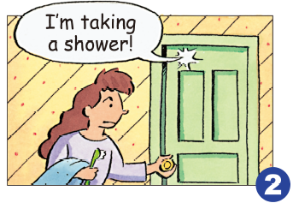
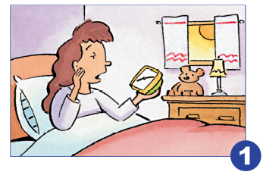
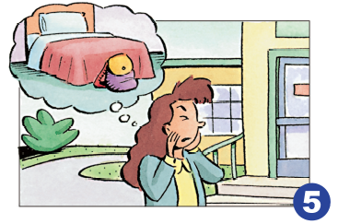
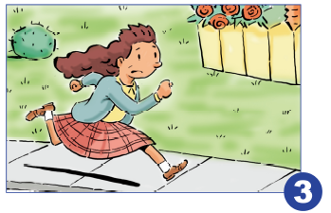
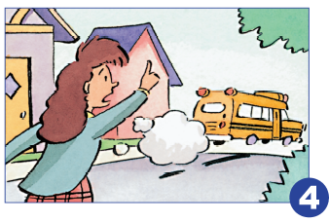
Mary’s morning
Her brother got in the bathroom
The girl got up, and she overslept
The bus left
She got to school/
She realized she left her backpack at home
She ran to the bus stop

Slide 3
By the time she got up, her brother had already gotten in the bathroom.
By the time she got to school, she realized that she had left her backpack at home.
By the time she got to the bus stop, the bus had already left.
got to the
bus stop
过去时
过去时
过去时
got up
got to school
past
future
过去完成时
过去完成时
过去完成时
past perfect
had gotten in the
bathroom
now
had left
had left her
backpack at home
Notes:
http://www.huiyi8.com/ppt/ ppt模板大全

Slide 4
The Past Perfect Tense
过去完成时
(1)用法：用来描述在过去某一时间或动作之前已经发生或完成了的动作。(过去的过去)
(2)构成：
肯定式：had(助动词、用于各种人称和数) + P.P.
否定式：had not + P.P.
疑问式：Had … + P.P. ?
简略回答：Yes, 主语 had. / No, 主语 hadn’t.
缩写式：I’d/ He’d/ We’d/ They’d

Slide 5
(3) 标志词：
表示过去某一时间发生的动作用by the time ,by the end of, before, when 引导 的时间状语从句；
表示过去的过去发生的动作常与already, since+时间点，for + 时间段连用。
(4) 口诀：
两个动作发生在过去，一个先发生， 一个后发生，
先发生的用过完，后发生的用过去。

Slide 6
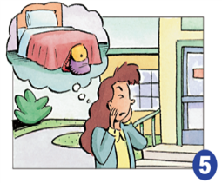
Mary’s morning
Mary had a terrible morning yesterday !
She . By the time she , her brother
in the bathroom. Before she
the bus stop, the bus . So She had to school. Oh, dear, when she
school, she realized she her backpack at home.
overslept
got up
had gotten
got to
had already left
run to
got to
had left
Notes:
http://www.huiyi8.com/ppt/ ppt模板大全

Slide 7

Let’s pk !
Boys VS Girls

Slide 8
Ten scores
1. We ____________ (paint) the house before we ______________ (move) in.
2. That rich old man _____________ (make) a will before he _______ (die).
3.The Reads ________ (have) lunch when I _______(get) to their house.

Slide 9
Ten scores
4.When I ______________(arrive) at
the station, he _____________(leave).
5.We __________ _ _(learn) about 4000 English words by the
end of last term.
6. We were surprised at what she ________already ______.(do)

Slide 10
Ten scores
7.She ____________(not go) to Qingdao because she_______ __ (go) there before.
8.He said he __ __ already__ ___
(give) the book to the teacher.

Slide 11
Ten scores
9. What _______ Annie ____ by
the time he was ten?
did, do B. did, did
C. has, done D. had done
10.He ___ in the factory for three
years before he joined the Army.
has worked B. works
C. had worked D. will work

Slide 12
Now, let's check !
had painted
1. We ____________ (paint) the house before we ______________ (move) in.
2. That rich old man _____________ (make) a will before he _______ (die).
3.The Reads ________ (have) lunch when I _______(get) to their house.
moved
had made
died
had had
got

Slide 13
Ten scores
4.When I ______________(arrive) at
the station, he _____________(leave).
5.We __________ _ _(learn)
about 4000 English words by the end of last term.
6. We were surprised at what she ________already ______.(do)
arrived
had left
had learnt/learned
had
done

Slide 14
Ten scores
didn’t go
7.She ____________(not go) to Qingdao because she_______ __ (go) there before.
8.He said he __ __ already__ ___
(give) the book to the teacher.
had been
had
given

Slide 15
Ten scores
9. What _______ Annie ____ by
the time he was ten?
did, do B. did, did
C. has, done D. had done
10.He ___ in the factory for three
years before he joined the Army.
has worked B. works
C. had worked D. will work
D
C

Slide 16

Summary
The past perfect tense
过去的过去
结构：had done
标志词： by the time ,by the end of, before, when

Slide 17

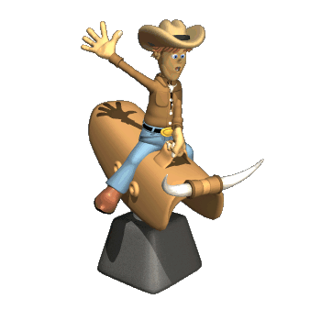
Thanks for listening

