Slide 1

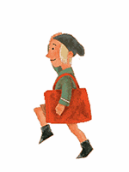

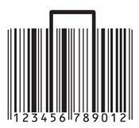

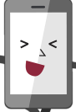
现在进行时

Slide 2
现在进行时
What is the girl doing?
The girl is walking.
女孩正在走路。
正在

Slide 3
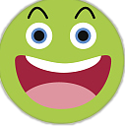


现 在 进 行 时
The Present Continuous Tense
正在进行或发生的事情及动作。
定义
主语+be动词（am/is/are）+动词ing+其他
结 构
Now、Listen、Look或上下文提示
标志

Slide 4
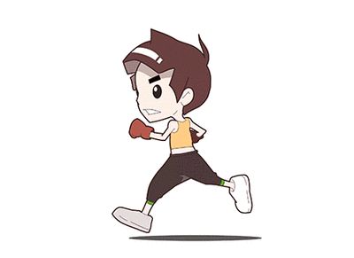
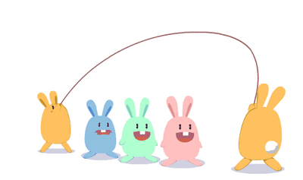


正在进行或发生的事情及动作。
The rabbits are jumping.
The boy is running.
I am driving a car.

Slide 5
主语 + be动词（am/is/are）+ 动词ing+其他
1. I am doing my homework now.
2. Listen! He is playing the piano.
3. They are dancing in the room.
4. Tom and Tim are swimming.
5. Look!The monkey is climbing the mountain.

Slide 6


give
swim
help
helping
giving
swimming
+ing
去不发音的e
+ing
双写尾字母
+ing

Slide 7
eat
come
sit
eating
coming
sitting
helping
giving
swimming
+ing
去不发音的e
+ing
双写尾字母
+ing

Slide 8

一般疑问句+特殊疑问句
Be+主语+动词ing+其他？
Is she playing the piano?
Yes,she is./No,she isn't.
What+be+主语+doing？
What is Linda doing?

Slide 9
Let's Practise
1. I ____ _________ baketball with my friends.(play)
2. She _____ _______ to school now.(go)
3. Listen! The bird ____ ________ on the tree.(sing)
4. Look! He _____ ________ on the playground.(run)
5.The dogs ____ ___________ in the river.(swim)
6._______your father___________ TV now?(watch)
am playing
is going
is singing
is running
are swimming
Is watching

