Slide 1
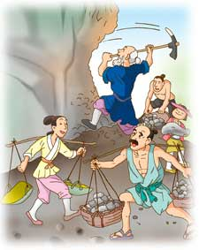
人教版新目标八年级下册
Unit6 An old man tried to move the mountains.
(SectionA 1a-1c)
---Tell the Chinese stories well to the world in English.(用英语向世界讲好中国故事）

Slide 2


Teaching Objectives
To learn new words: remind，shoot, weak, stone, god…
To learn to tell a story in English.
To learn the spirit of Yu Gong.

Slide 3
Lead-in
1. Do you like reading stories?
2. What kind of stories do you like?
3.Do you like Chinese fairy tales(中国神话故事）?

Slide 4
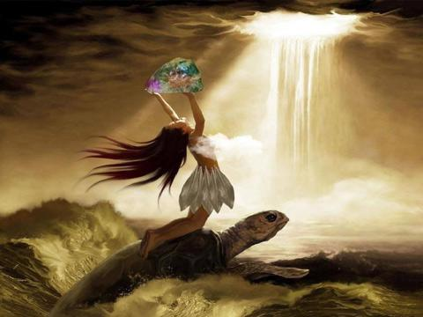
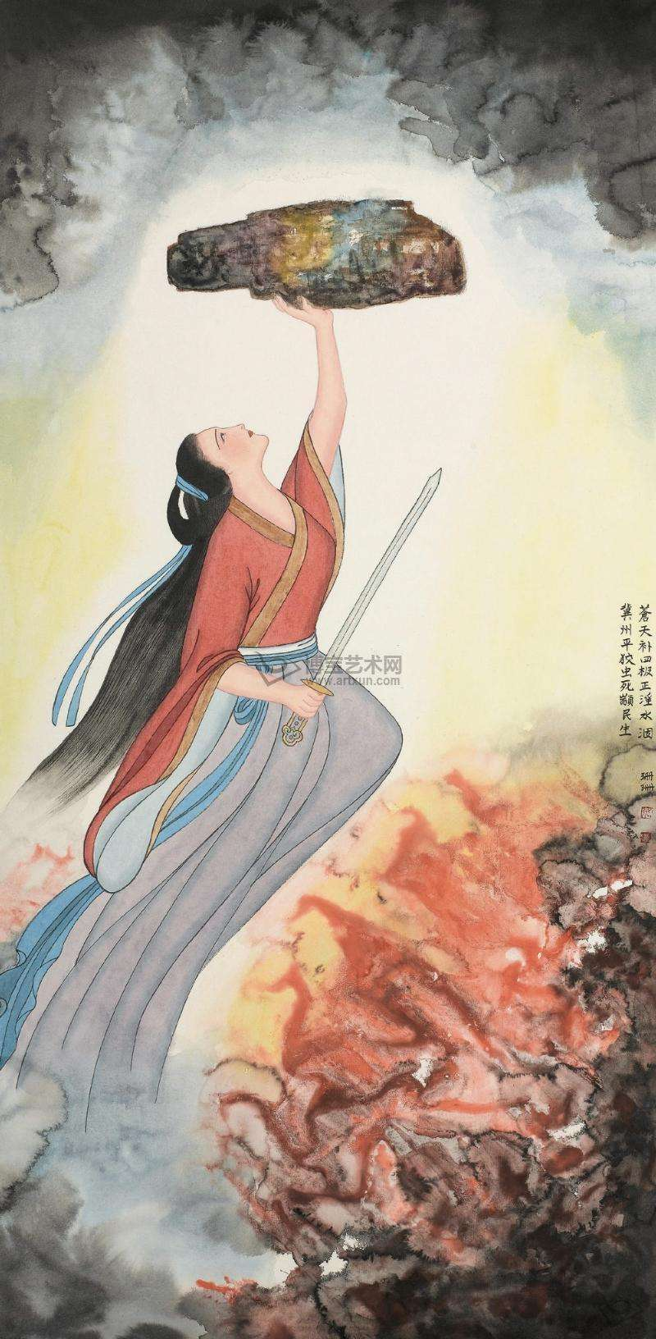
Can you tell what Chinese fairy tales they are?
Nu Wa Repairs the Sky

Slide 5
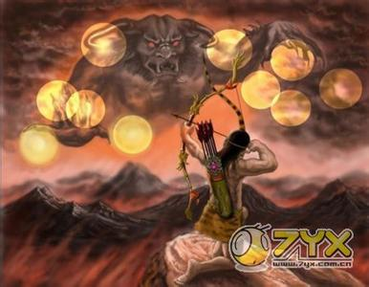
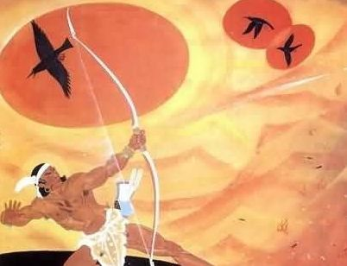
v. 射击（过去式：shot)
Hou Yi Shoots the Suns

Slide 6
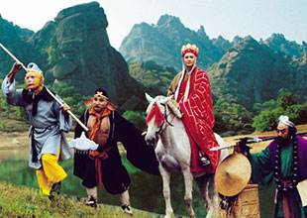
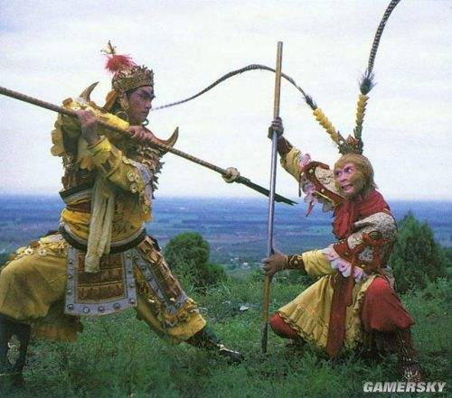
Journey to the West

Slide 7
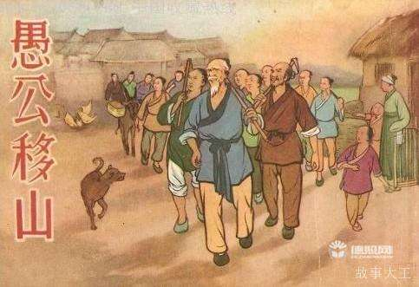
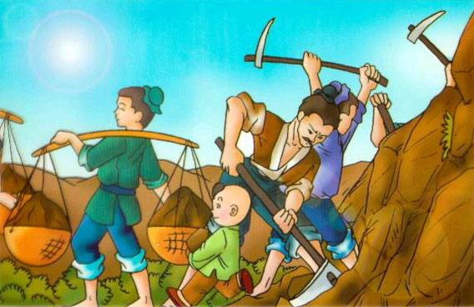
Yu Gong Moves a Mountain

Slide 8

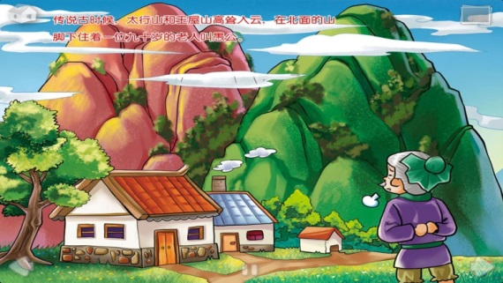
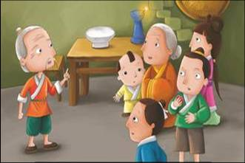
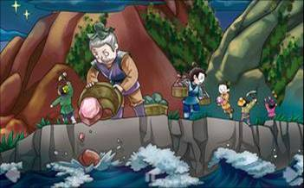
1b
Listen and fill in the blanks.
Once upon a time, there was
__________ .There were _______ _ near his house. They were so_________ that it ___________ to walk to the other side.
Listening skills:
Before listening,read and try to predict.
While listening,just write down the first letter of the key words you hear.
After listening,complete the whole word.
a very old man
two mountains
big and high
took a long time
The old man told his family that they should all____him ________the mountains.
help
to move
For the earth and stone, Yu Gong said they could put them because it’s _________ to hold everything.
into the sea
big enough

Slide 9

Does the story end?
What happened next?

Slide 10
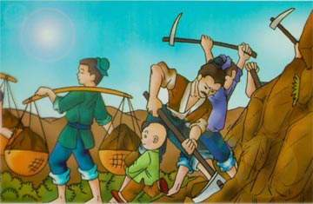
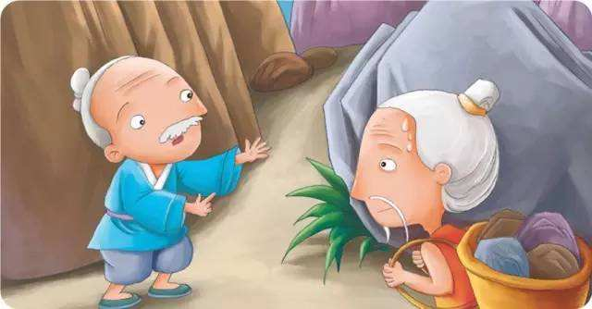
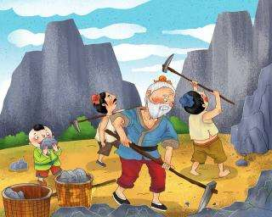
After that, they began to put the earth and stones into the sea every day.
One day, a man called Zhi Sou saw Yu Gong and told him he could never do it because he was old and weak.
As soon as the man finished talking , Yu Gong and his family continued to move the mountains day after day and year and year.

Slide 11
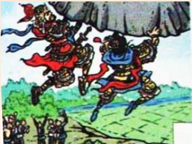

Finally, a god（神仙） was so moved by Yu Gong that he sent two gods to take the mountains away.
This story reminds（提醒） us that you can never know what’s possible unless you try to make it happen.

Slide 12
1c
Can you retell the story of Yu Gong?
1. How does the story begin?
2.What happened next?
3.What is the ending of the story?
4.What does the story remind us?
Pictures can help us a lot!

Slide 13

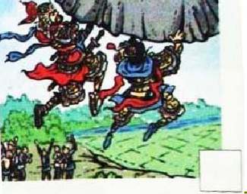
a very old man /two mountains /high and big /took a long time
A picture chain 图片链
help…to move the mountains
put…into the sea
was moved..by ..../
sent…totake…away
finished talking / continued to move day after day
saw /never do it / old and weak /
reminds.. unless.. make it happen

Slide 14




Activity(work in group)
Yu Gong Moves a Mountain

Slide 15
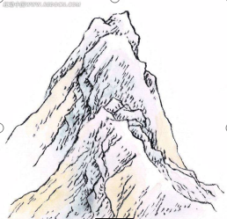
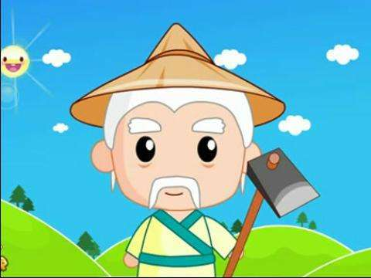
Summary
Do you have any “ ” in your daily life?
“ ” : difficulties and trouble we meet.
We should learn the spirit of “Yu Gong” ---be brave, never giveup...
You will never know what’s possible unless you try to make it happen！(奇迹是创造出来的！）

Slide 16
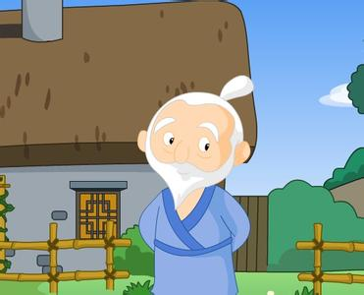
Homewrok
1. Tell the story Yu Gong Moves a Mountain or other stories in English to your parents.
2. Write down your own opinions about Yu Gong and Zhi Sou.

Slide 17


