Slide 1
UNIT 4 Don't eat in class.
School rules

Slide 2




课 堂 导 入
Do you know the meanings of the following signs?
No talking!
No fire!
No mobile phones!

Slide 3

Do you know the places that have rules? And what rules do you know?
family rules
家规
school rules
校规
class rules
班规
library rules
图书馆规则
dining rules
就餐规则

Slide 4
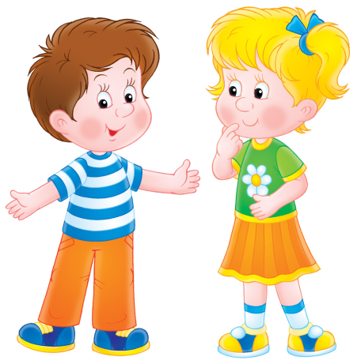
Living in the society,
we have to
keep rules
遵守规则
we can’t
break rules
违反规则

Slide 5

课 堂 学 习
How to be a good student?
What can we do at school?
What can’t we do at school?

Slide 6
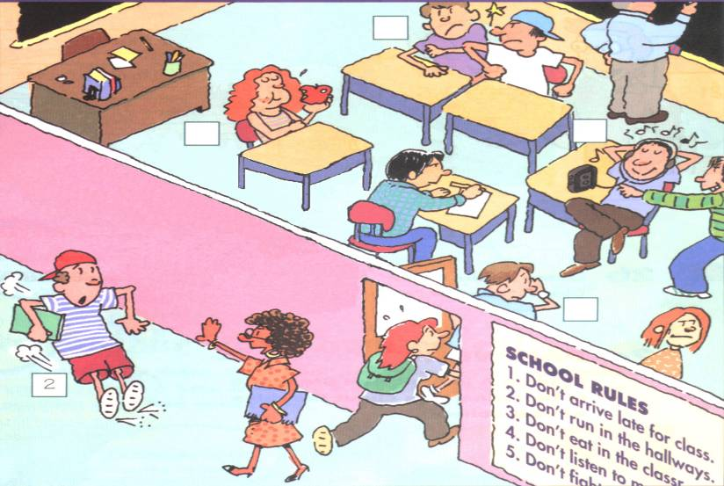
Look and say
Don’t fight.
Don’t eat in the classroom. You must eat in the dining hall.
Don’t arrive late for class. You must be on time.
Don’t listen to music in class.
Don’t run in the hallways.

Slide 7
Talk about your school rules
while-reading
Don’t arrive late for class.
Get to school on time
2. Don’t wear jeans to school.
Wear the school uniform to school.
3. Don’t fight with your classmates.
Be friendly to your classmates.

Slide 8
Talk about your school rules
while-reading
4.Don’t run in the classroom.
5. Don’t eat in class.
Eat in the dining hall.
6. Don’t listen to a CD in class.
7.Don’ t forget to do your homework.
8.Don’t bring music players to school.
9. Listen to your teacher carefully.

Slide 9

Language points

Slide 10
Language points
1. Don’t arrive late for class.不要上课迟到。
arrive vi. 到达
When did he arrive yesterday?
昨天他什么时候到达的？
【拓展】arrive in / at与get to 的区别
arrive + in （大地方）
at （小地方）
get 必须与to 搭配才能加宾语。后面如接地点副词，则不用介词to。

Slide 11
2. You must be on time.
你们必须守时。
1) must 作为情态动词，表示“必须”、“务必”，有时还表示“一定”，起到加强语气的作用。例如：
You must come tomorrow.你（们）明天必须要来。
在回答must引起的问句时，如果是否定的答复，可用don’t have to或needn’t (不必) , 但不能用mustn’t (一定不, 必须不, 不允许, 不得) 。

Slide 12
2) on time 是一个固定介词短语，表示“按时；准时”。 例如：
We must get to school on time.
我们必须按时到校。
我们要按时完成任务。
We'll finish our job _________.
on time

Slide 13
3) 系动词be与形容词或介词短语连用，是英语一种常见的语句结构，表示某种状态。例如：
be quiet 保持安静；be strict 要求严格
be on time 守时；按时到；
be at work 在上班
例如：
You mustn’t be noisy, children.
孩子们，你们一定不可喧闹。

Slide 14
4. wear a hat 戴帽子
wear v. 穿；戴
The girl often wears a red coat and a white hat.
这个女孩经常穿着红色的外套戴着白色的帽子。

Slide 15
put on着重于“穿”这一动作，即由没穿到穿这一过程的完成，意为“穿上”。如：
Please put on your new coat.
请穿上你的新大衣。
用 wear, put on, dress 的适当形式填空。
She is _________ a red flower in her hair.
2. He ________ his coat and goes out.
3. He is _________ black.
wearing
puts on
dressed in

Slide 16
5. Can we bring music players to school?
我们能把音乐播放机带到学校来吗？
bring v. 带来；取来
Can you bring me an English dictionary?
你能给我带来一本英语字典吗？

Slide 17
【拓展】bring 与 take 的区别
Bring your homework here, and take the book away.
把你的作业拿过来，把这本书带走。
bring 指往里带，而take 则指往外带。
---Why do Chinese people like red?
---Because they think it can ____ them good luck.
A. carry B. bring C. make D. take
B

Slide 18
课 堂 小 结
祈使句
1.祈使句是表示命令、叮嘱、号召等的句子;
2.通常省略主语you;
3.句中谓语动词用动词原形;
4.祈使句有肯定和否定两种。
否定
Don’t eat in class.
Don’t play sports in the classroom.
Don’t fight .
Come in, please! 请进！
Sit down, please. 请坐。
肯定

Slide 19
Examples
肯定祈使句 否定祈使句
Sit down.
Come in.
Eat at home.
Listen to music outside.
5. Do your homework at school.
Don’t sit down.
Don’t come in .
Don’t eat at home.
Don’t listen to music outside.
Don’t do your homework at school.

