Slide 1

_{新人教版英语八年级下册}
Unit 2
I’ll help to clean up
the city parks.
Section B Reading
中物理

Slide 2


To read and learn the story of Ben Smith
To learn new words and phrases:
Miss, disabled, blind, deaf, imagine, difficulty, open, door, carry, train, excited, training, kindness, clever, understand, change,
To learn to thank others when we get help from them.

Slide 3
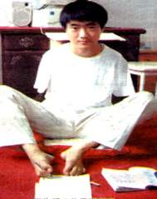
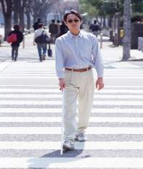

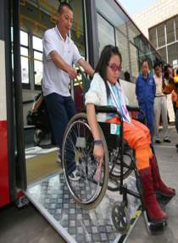
Lead in
blind
deaf
unable to use hands
unable to walk
disabled people

Slide 4
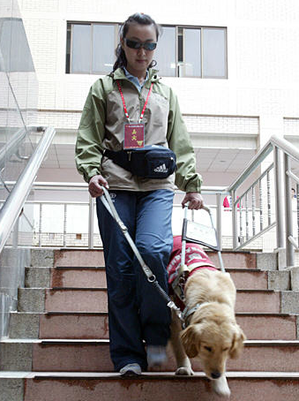
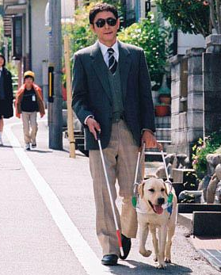
How can we help them?
A dog helper

Slide 5

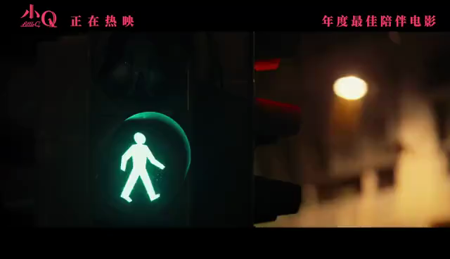
We could train animals like dogs to help them.
A dog helper is a special kind of dog . Its job is to help disabled people. With training, it can do many amazing jobs. After training, it can help put dirty clothes into the washing machine. It can turn lights on and off. It can open and close doors. Some dogs can even help their owners answer the telephone calls.

Slide 6
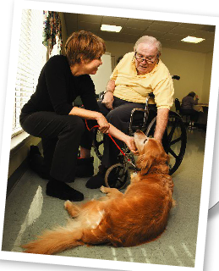
Before reading
Look at the picture and guess
What's wrong with the man?
Is the dog a dog helper?

Slide 7
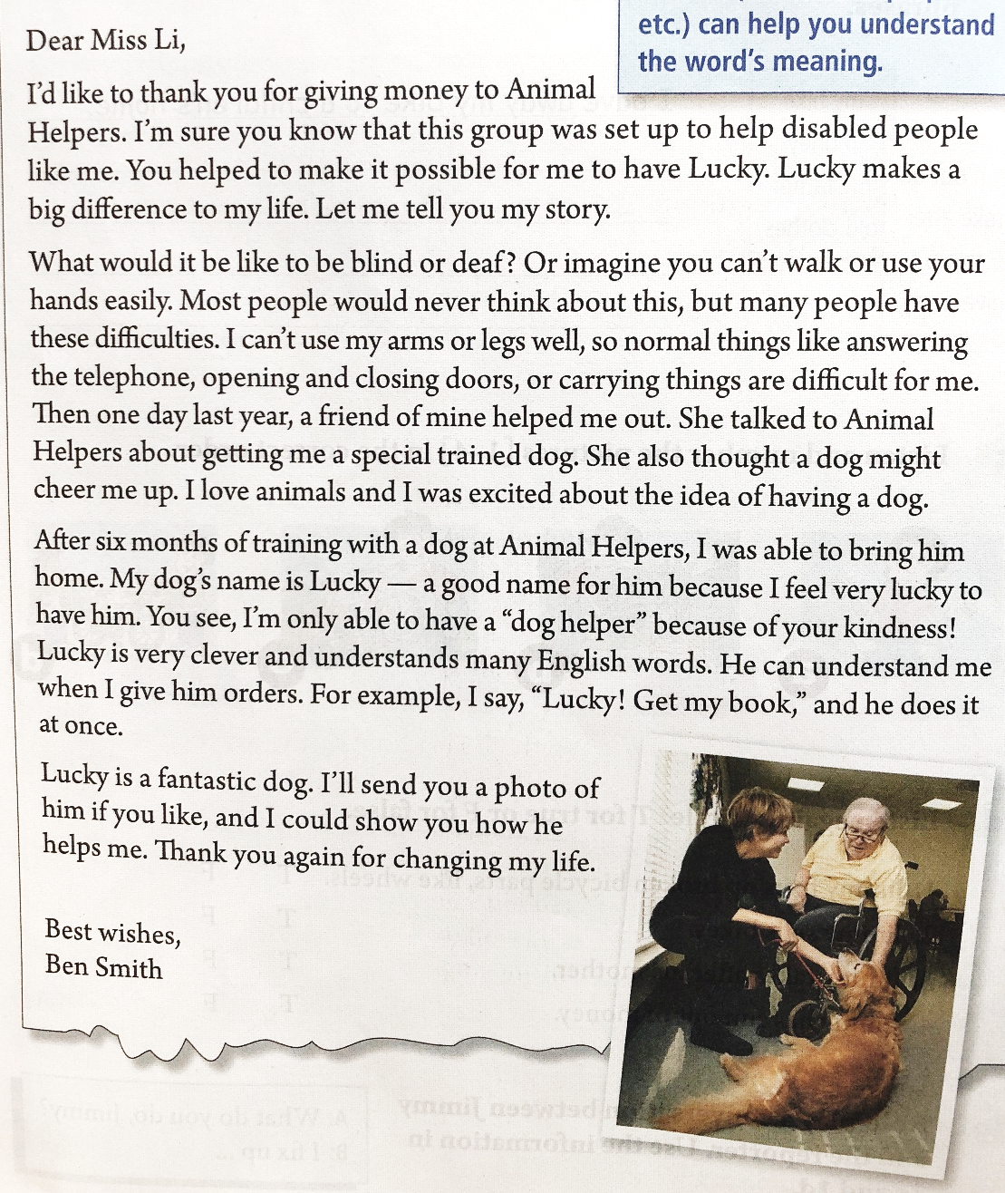
2b
Skimming
Who wrote ?
Ben Smith
Why ?
thank
Miss Li
Who got?

Slide 8
Skimming
Match each paragraph with its main idea .
Para1
1. Lucky is a clever dog.
2. Ben Smith thanks Miss Li again .
Para2
3. Ben Smith 's difficulties in his life and his feiend's advice to solve them.
Para3
Para4
4. Ben thanks Miss Li for helping him to have Lucky.

Slide 9
While-reading
Read Para 1 and answer the following questions.
Dear Miss Li,
I’d like to thank you for giving money to Animal Helpers . I’m sure you know that this group was set up to help disabled people like me . You helped to make it possible for me to have Lucky . Lucky makes a big difference to my life. Let me tell you my story.
It is a group that was set up to help disabled people like the writer.
1.What is Animal Helpers ?
Lucky makes a big difference to his life.
2. What influence does Lucky have to writer?

Slide 10
Read Para. 2 and answer the following questions
What would it be like to be blind or deaf ? Or imagine you can’t walk or
use your hands easily . Most people would never think about this , but many people have these difficulties . I can’t use my arms or legs well , so normal things like answering the telephone , opening and closing doors , or carrying things are difficult for me . Then one day last year , a friend of mine helped me out . She talked to Animal Helpers about getting me a special trained dog . She also thought a dog might cheer me up. I love animals and I was excited about the idea of having a dog .
What do most people never think about ?
What difficulties does Ben have?
answer the phone
to be deaf
can’t use hands
carry things
can’t use arms or legs
to be blind
can’t walk
open and close doors

Slide 11
Read para.3 and Para.4 and answer the question
After six months of training with a dog at Animal Helpers, I was able to bring him home.My dog's name is Lucky---a good name for him because I feel very lucky to have him. You see, I'm only able to have a “dog helper” because of your kindness! Lucky is very clever and understands many English words. He can understand me when I give him orders. For example, I say, “Lucky! Get my book,” and he does it at once.
Lucky is a fantastic dog.I'll send you a photo of him if you like, and I could show you how he helps me. Thank you again for changing my life.
Best wishes,
Ben Smith
1.How long did the Animal Helpers train the dog?
2.what does the writer think of Lucky and why?
3.Can Lucky get the book for Ben?
Six months
Clever and fantastic. Because he can understand many English words and orders.He often helps the writer.
Yes,he can.

Slide 12
Read the letter again and tell “T” or “F”.
T
1. The writer can’t use his arms or legs well.
2. The owner and the dog have been trained at “Animal helpers” for seven months.
3. A dog-helper is for those who are disabled.
4. Lucky can understand different orders.
F
T
T

Slide 13
gave money
Salutation(称呼)
Animal Helpers
Body
trained
express thanks
Lucky
Do you know the main structure of a letter?
clever
wrote the letter
dog helper
make a difference to his life
Signature

Slide 14
Fill in the blanks with the proper words.
disabled
Ben Smith is a _________ man. He has many __________ in his life. He can’t _____ his _____ or legs well. Some normal things like answering the telephone, ________ and closing the doors, or ________ things are difficult for him. But “Lucky”, the dog-helper, makes ___________ to his life. Lucky is a fantastic dog. It is very _______ and ___________ many English words. It can understand him when he gives him order. It makes a big ____________ to his life.
difficulties
use
arms
opening
carrying
differences
clever
understands
difference

Slide 15
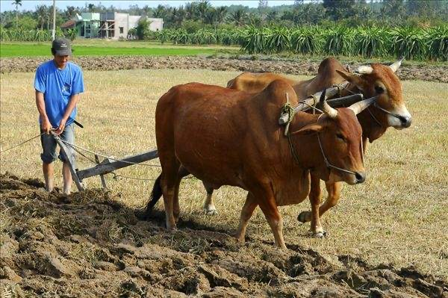
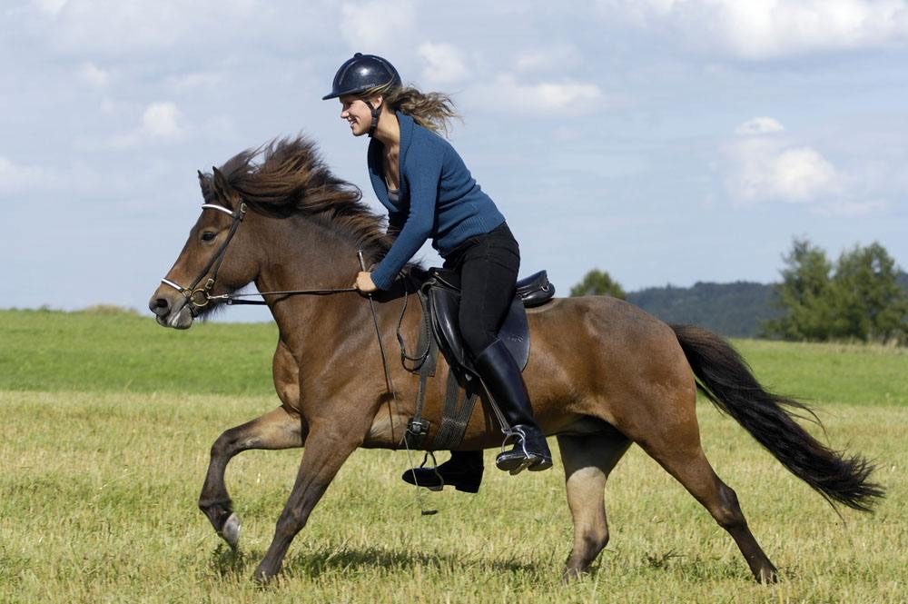
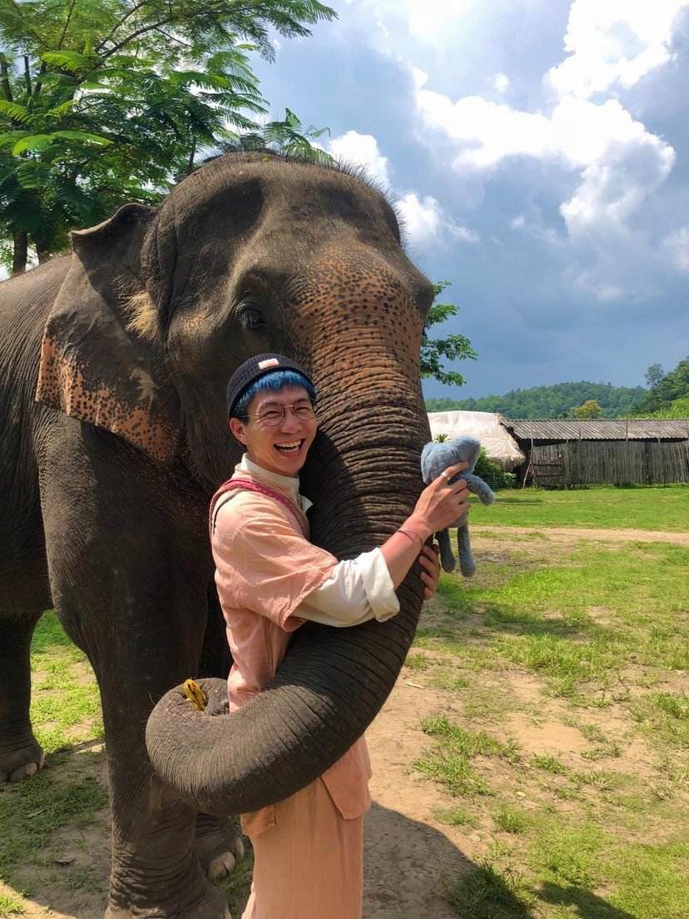
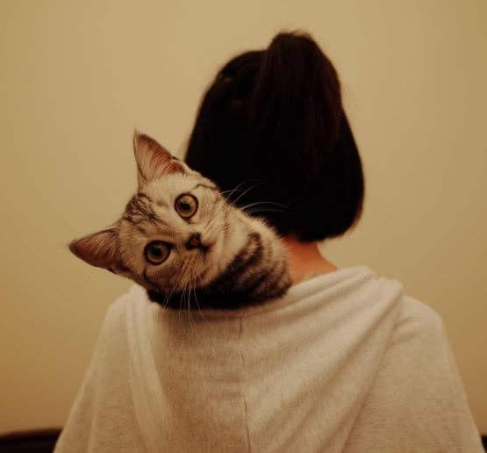
Not only dogs but also other animals are able to help us in different ways , so we should protect them and make good friends with them.

Slide 16


根据汉语意思完成英语句子，每空一词。
1.我们打算在那儿建一个食物赈济站。
We are going to ____ ____ ____ _____ _____there.
2. 在美国三个月的培训将会对她有影响。
The three-month training in America will ________ ____ _________ ______ her.
3.上周末，我们帮助残疾人上下公交车。
Last weekend,we helped _________ __________ get on and off the buses.
set up a food bank
make a difference to
the disabled/
disabled people

Slide 17


Review the new words and expressions of page 14 and retell Ben's letter.

Slide 18


