Slide 1

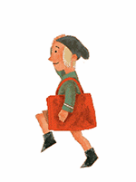

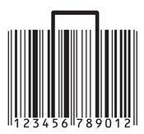

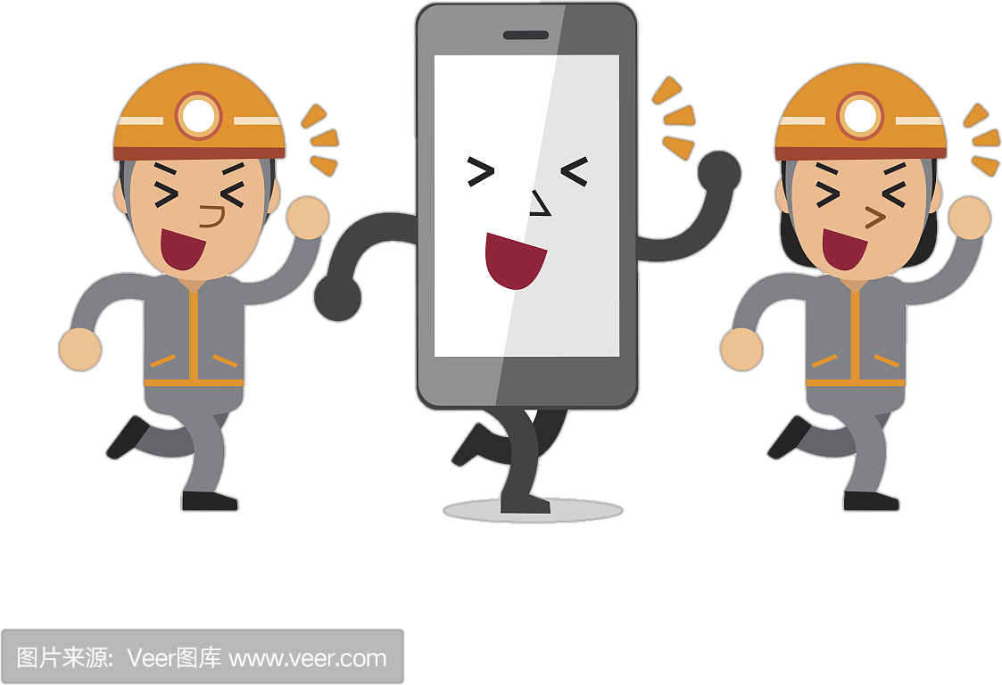
人教版七年级下
Unit6 I'm watching TV.
Grammar Focus
现在进行时

Slide 2

Let's chant
现在进行时
be eating, be drinking,
be talking on the phone.
be making, be writing,
be dancing in the room.
be sitting, be running,
be swimming in the pool.

Slide 3

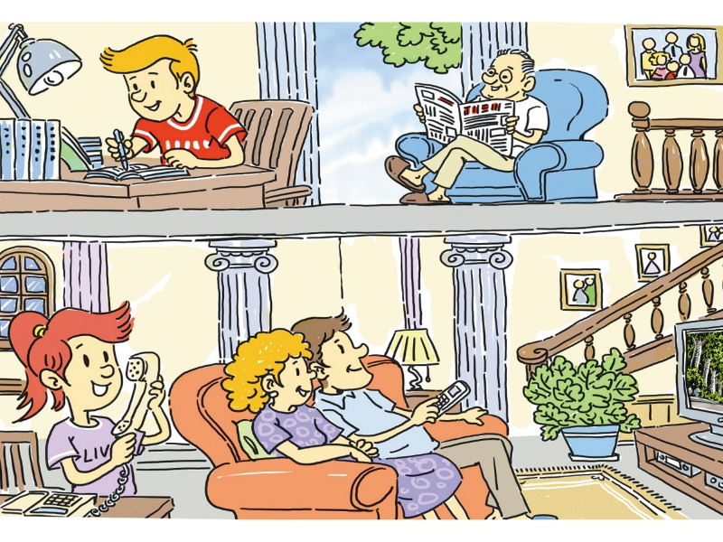
Mary's family
is talking on the phone
doing his homework
reading a newspaper
are watching TV

Slide 4


Presentation
S: Is he V-ing…?
T: Yes, he is.
No, he isn't.
Yes, he is.
He is playing the guitar.

Slide 5

S: Is she listening to music ?
T: Yes, she is.
No,she isn't.
No,she isn't.
She is drinking.

Slide 6

S: Are they singing…?
T: Yes, they are.
No, they aren't.
No, they aren't.
They are dancing.

Slide 7
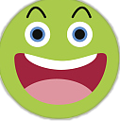

Summary
现 在 进 行 时
The Present ProgressiveTense
正在进行或发生的事情及动作。
定义
主语+be动词（am/is/are）+动词ing+其他
结 构
Now、Listen、Look或上下文提示
标志

Slide 8
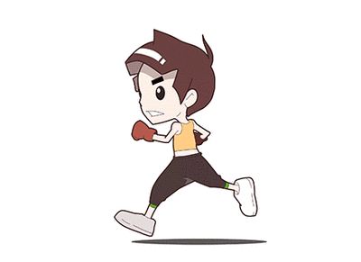
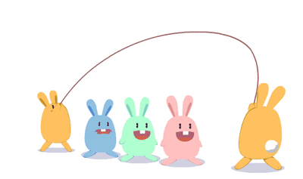

正在进行或发生的事情及动作。
The rabbits are jumping.
The boy is running.
I am driving a car.

Slide 9
主语 + be动词（am/is/are）+ 动词ing+其他
1. I am doing my homework now.
2. Listen! He is playing the piano.
3. They are dancing in the room.
4. Tom and Tim are swimming.
5. Look!The monkey is climbing the mountain.

Slide 10


give
swim
help
helping
giving
swimming
+ing
去不发音的e
+ing
双写尾字母
+ing

Slide 11
eat
come
sit
eating
coming
sitting
helping
giving
swimming
+ing
去不发音的e
+ing
双写尾字母
+ing

Slide 12

一般疑问句+特殊疑问句
Be+主语+动词ing+其他？
Is she playing the piano?
Yes,she is./No,she isn't.
What+be+主语+doing？
What is Linda doing?

Slide 13
Let's Practise
1. I ____ _________ baketball with my friends.(play)
2. She _____ _______ to school now.(go)
3. Listen! The bird ____ ________ on the tree.(sing)
4. Look! He _____ ________ on the playground.(run)
5.The dogs ____ ___________ in the river.(swim)
6._______your father___________ TV now?(watch)
am playing
is going
is singing
is running
are swimming
Is watching

